Slide 1
COMP 469
Introduction to Artificial Intelligence
Reinforcement Learning I
Model-Based Learning · Temporal Difference Learning · Q-Learning
California State University Channel Islands
AIMA 4th edition, Sections 22.1 – 22.3
Adapted from UC Berkeley CS 188 (Klein and Abbeel), Lecture 11
Notes:
[2 min] Open the class here. Frame the whole lecture in one sentence before touching a formula: for four lectures we have assumed somebody hands us the model. Today we take that away and the agent has to learn by doing. Attribution note: this deck follows the structure of Berkeley CS 188 Lecture 11 and the AIMA 4e treatment in Chapter 22. Tell students the Berkeley slides and demos are freely available at ai.berkeley.edu if they want a second pass. Housekeeping to mention now, not later: Project 3 is the crawler and gridworld Q-learning agent, so everything today is directly implementable. ------------------------------------------------------------- PACING PLAN FOR A 120-MINUTE SLOT ------------------------------------------------------------- 0:00 Part 1 Why learning is not planning 12 min 0:12 Part 1 Motivating problems 9 min 0:21 Part 2 RL as an unknown MDP 4 min 0:25 Part 3 Model-based learning 14 min 0:39 Part 4 Model-free, the age argument 7 min 0:46 Part 5 Passive RL and direct evaluation 14 min 1:00 BREAK 10 min 1:10 Part 6 Temporal difference learning 20 min 1:30 Part 7 Q-learning 26 min 1:56 Part 8 Wrap-up and next session 8 min 2:04 ends with four minutes of slack Slides marked OPTIONAL in their notes add 25 minutes of material. Drop them first if you fall behind; keep them if your section runs long or if you are splitting this across two 75-minute meetings. Two things not to cut under any circumstances: the direct-evaluation critique where B and E disagree, and the Q-learning worked trace. Those two slides carry the lecture.

Slide 2
Where this sits in the course
Search
Deterministic, known world. Plan a path.
Chs. 3 – 5
CSPs and Logic
Structure and inference over constraints.
Chs. 6, 8
MDPs
Stochastic, known world. Plan a policy.
Ch. 17
Reinforcement Learning
Stochastic, UNKNOWN world. Learn a policy.
YOU ARE HERE
Ch. 22
Probabilistic Reasoning
Belief over hidden state. Coming later.
Chs. 12 – 14
COMP 469 · Reinforcement Learning I · CSU Channel Islands
2
Notes:
[2 min] Draw the arc explicitly. Each row removed one convenience. Search: the world is deterministic and fully known, so a sequence of actions is enough. MDPs: outcomes became stochastic, so a sequence is not enough and we needed a policy - but we still knew T and R. Today: T and R go away. That is the only change. Everything else in the formalism survives intact. Ask the room before advancing: 'if you do not know T, which of the algorithms from last lecture still runs?' The honest answer is none of them, and that is the problem we solve today.

Slide 3
Learning objectives
By the end of this session you should be able to do all six of these unaided.
1
State the RL problem as an MDP with T and R removed, and explain why that single change breaks value iteration.
2
Build an empirical model from observed episodes and solve it (model-based learning).
3
Explain why a running average of samples estimates an expectation without ever building the model.
4
Run direct evaluation by hand, and say precisely what information it discards.
5
Apply the temporal difference update to a transition and compute the new value.
6
Apply the Q-learning update, and explain why the max makes it off-policy.
Objectives 5 and 6 are the two you will be asked to execute on paper.
COMP 469 · Reinforcement Learning I · CSU Channel Islands
3
Notes:
[1 min] Read objectives 5 and 6 aloud and say plainly that these are the exam mechanics. Students consistently under-practise doing the updates by hand and then lose points for arithmetic, not for concepts. Objective 3 is the conceptual hinge of the whole lecture. If they only remember one sentence, it should be that one.

Slide 4
Reading and source map
AIMA 4th edition
Berkeley CS 188
22.1
Learning from Rewards
Lec 11
Reinforcement Learning I
22.2
Passive Reinforcement Learning
Demo
Gridworld Q-learning
22.2.1
Direct utility estimation
Demo
Crawler bot
22.2.2
Adaptive dynamic programming
Project 3
Q-learning agent
22.2.3
Temporal-difference learning
22.3.3
Temporal-difference Q-learning
Deferred to RL II: exploration strategies (22.3.1), safe exploration (22.3.2), and approximate Q-learning (22.4).
COMP 469 · Reinforcement Learning I · CSU Channel Islands
4
Notes:
[1 min · OPTIONAL, cut this first if you are behind] Point out the gap deliberately. AIMA 22.3.1 and 22.3.2 are the exploration material and we are not covering it today - we will end the lecture at exactly the point where it becomes unavoidable. Tell students that AIMA calls direct evaluation 'direct utility estimation' and calls model-based RL 'adaptive dynamic programming'. Berkeley uses different names for the same algorithms. They will see both in the literature.

Slide 5
1
AIMA 22.1
Why learning is not planning
The formalism does not change. One assumption disappears, and every algorithm we have built stops working.
COMP 469 · Reinforcement Learning I · CSU Channel Islands
5

Slide 6
LAST LECTURE
You were handed the model
V*(s) = maxₐ Σₛ' T(s, a, s') [ R(s, a, s') + γ V*(s') ]
Every symbol on the right-hand side was available to you before the agent moved. T and R were part of the problem statement, so value iteration could be run to convergence in advance, offline, without ever touching the world.
T(s, a, s')
R(s, a, s')
γ
π*(s)
Where actions take you
What outcomes are worth
How much the future counts
What to do in each state
GIVEN
GIVEN
GIVEN
COMPUTED
Planning is a computation you perform before you act. Nothing is at stake while you do it.
COMP 469 · Reinforcement Learning I · CSU Channel Islands
6
Notes:
[2 min] This is deliberate revision. Do not rush it - the contrast on the next slide only lands if this one is fresh. Emphasise the word 'offline'. In the MDP setting you can imagine falling into the pit a thousand times and it costs nothing, because the falling happens inside a model. The three blue boxes are inputs; the green box is the output. Ask: 'which of these four is the agent actually trying to produce?' Answer: the policy. That stays true today. Only the inputs change.

Slide 7
THIS LECTURE
The model is gone
V*(s) = maxₐ Σₛ' ? (s, a, s') [ ? (s, a, s') + γ V*(s') ]
There is still an MDP underneath. It is simply unknown to the agent. Until you have stood in a state and taken an action, you do not know what it does or what it pays.
You cannot compute an expectation
the weights T(s, a, s') are missing
You cannot evaluate an action in advance
you do not know what it leads to
You cannot tell a good state from a bad one
until you have visited it and been paid
You cannot practise for free
there is no simulator to fail inside
Learning is not a computation you perform before acting. Acting is how the computation gets its inputs.
COMP 469 · Reinforcement Learning I · CSU Channel Islands
7
Notes:
[2 min] Put the two formula slides side by side mentally for the class. The equation is character-for-character identical except that two terms became question marks. Stress the last row hardest. In search, an unexplored frontier node is still there if the current plan fails - you can back up. In RL there is no backing up. If you jump in the fire, you have jumped in the fire. Concrete example students respond to: learning to fly a helicopter by RL means you will destroy several helicopters. That is not a flaw in the algorithm, it is the cost structure of the problem.

Slide 8
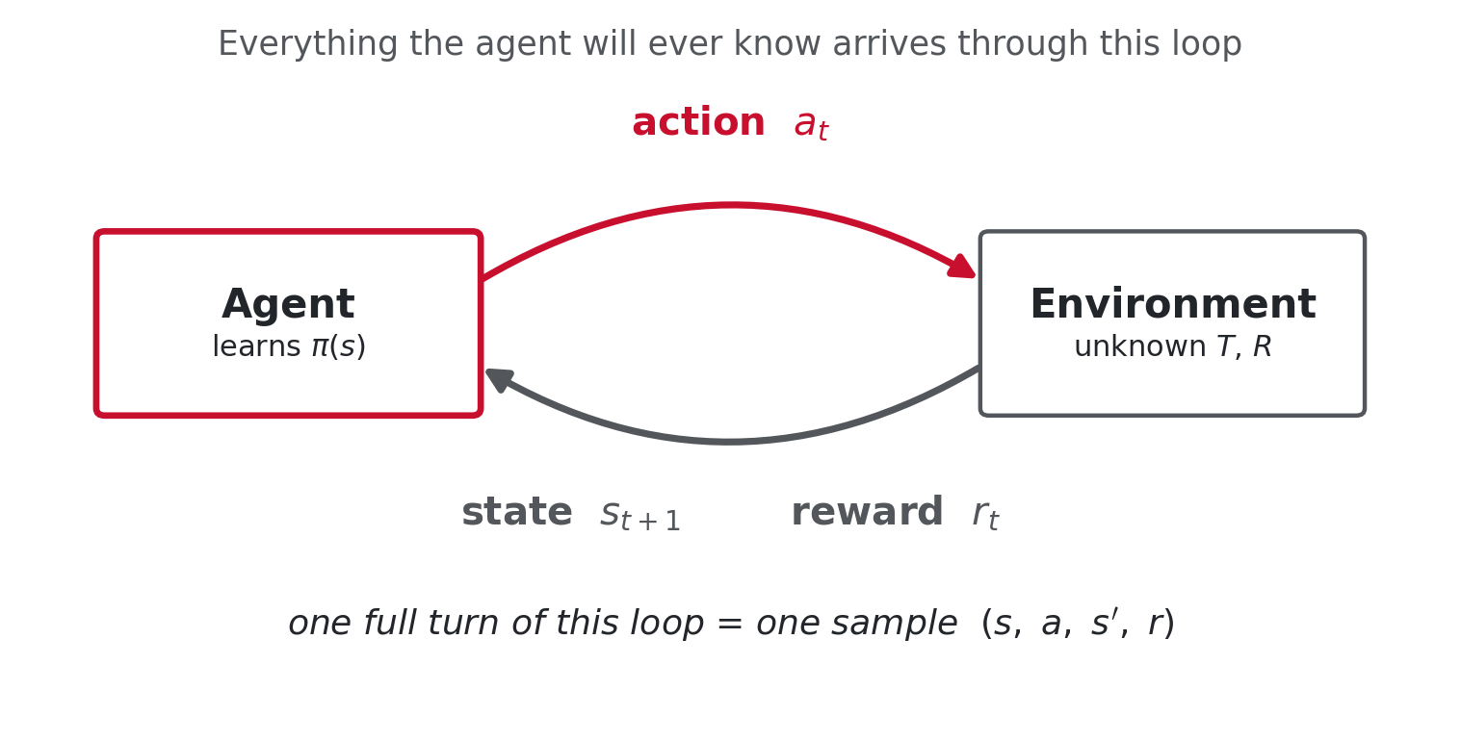
The only channel the agent has
Action out, state and reward back. Repeat. That is the entire interface.
s
the state you are in
a
the action you chose
s'
where you actually ended up
r
what you were paid for it
COMP 469 · Reinforcement Learning I · CSU Channel Islands
8
Notes:
[2 min] Everything in this lecture is an answer to one question: what can you do with a stream of these four-tuples? Two assumptions worth naming out loud now: 1. Full observability. The agent always knows which state it is in. Drop that and you get a POMDP, which we handle much later in the course. 2. The reward arrives per transition, not at the end. The agent is maximising the discounted SUM, which is why a locally negative step can be correct. Good moment for the hopping-robot intuition: a one-legged hopper has to push slightly backward on each step to move net forward. No greedy view of a single reward would ever discover that.

Slide 9
MOTIVATION
Three problems nobody can write down a solution for
1
Quadruped gait
2
Sidewinding snake
3
The crawler
Kohl and Stone, ICRA 2004
Ng et al.
Project 3
Reward: net forward distance per trial.
The learned gait is not the obvious straight-legged one. It drops onto the elbows for support.
Retuning is needed on a new field, because turf changes how much the legs slip.
A dozen joints that must be phased against each other.
A human can script a four-legged walk. Scripting a coordinated many-joint sidewind is far harder.
The forces have to sum to net motion rather than to thrashing.
Two controllable angles: shoulder and elbow.
Some cycle of raising and lowering them produces a net forward scoop.
The robot has no built-in concept of walking. It has to find the cycle.
Common thread: the reward is easy to state and the behaviour that earns it is impossible to specify.
COMP 469 · Reinforcement Learning I · CSU Channel Islands
9
Notes:
[3 min] If you have the Berkeley video clips, play the AIBO walk here: initial, training, finished. Roughly 1,000 trials between the first and last clip. The pedagogically important observation is the contrast between case 2 and case 1. A student will reasonably object to case 1: 'I could hand-script a walking gait for a four-legged robot.' Concede that. Then point at the snake. Twelve coupled joints where the forces have to sum correctly is not something a person writes down. Also note the hybrid path used in practice: train in a best-guess simulator, then polish with real-world RL. Simulation is only as good as your model, and the residual is exactly what RL is for. Start the crawler applet running in the background now and leave it running for the rest of the lecture. Students will watch it improve while you lecture, which does more for intuition than any slide.

Slide 10
A CAUTIONARY TALE
Can you teach a cat to fetch?
The experiment: throw a ball the way you would for a dog, three times, and watch what the cats learn.
Iteration 1
Iteration 2
Iteration 3
Ball thrown. Cats absent.
Cats present, facing the camera, ignoring the ball.
Cats walking away. Fully disengaged.
This is reinforcement learning working correctly.
No reward was ever wired up for fetching. So the cats learned the optimal policy for the reward function that actually existed, which was to conserve energy and ignore the ball.
You get what you reward, not what you meant to teach. Reward design is the hardest unforced error in applied RL.
COMP 469 · Reinforcement Learning I · CSU Channel Islands
10
Notes:
[2 min] Play this for laughs and then turn it. Students remember the joke and the joke carries the lesson. The serious version is reward hacking, and it is worth naming real cases: a boat-racing agent that learned to spin in circles collecting respawning power-ups instead of finishing the race; a simulated robot that learned to topple over rather than walk because the reward measured height of the head. Tie it to their own work: in Project 3 you will choose living rewards and discount factors. Those choices are the reward design, and small changes flip the optimal policy from 'take the safe long path' to 'risk the cliff'. Security-minded framing that lands well with this cohort: the reward function is the specification, and anything unspecified is fair game for the optimiser. That is the same failure mode as an overly permissive access policy.

Slide 11
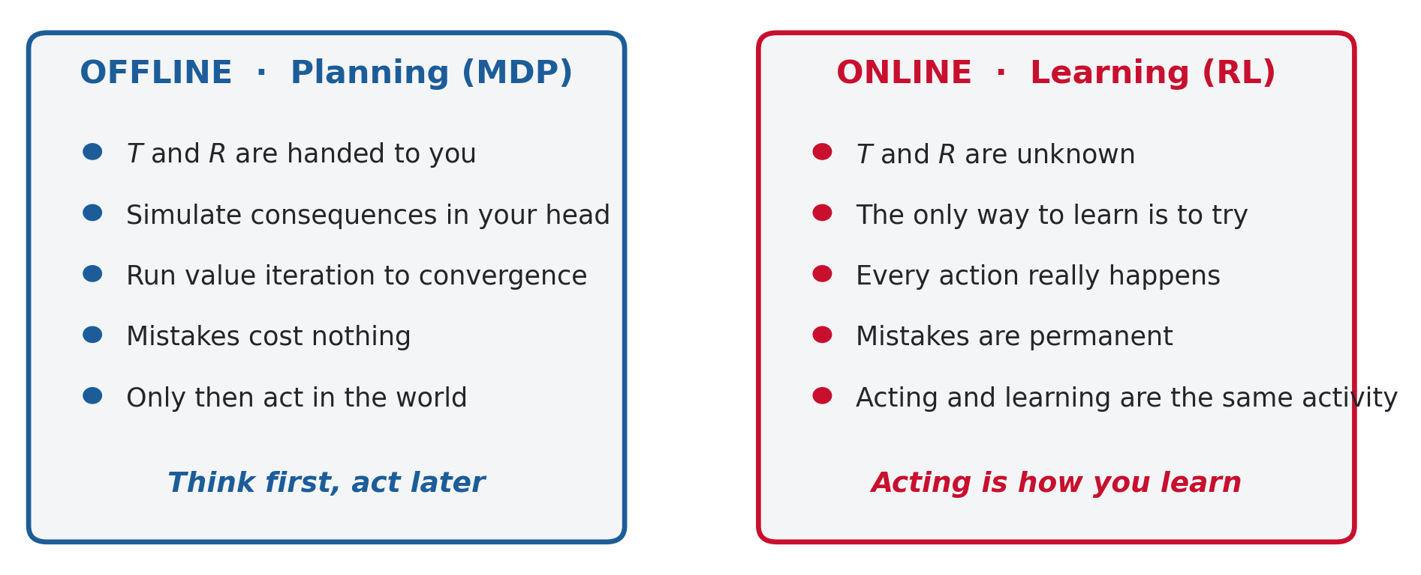
Offline planning versus online learning
Same MDP. Completely different relationship with failure.
In planning, a mistake is a discarded branch of a search tree. In learning, a mistake is a mistake.
COMP 469 · Reinforcement Learning I · CSU Channel Islands
11
Notes:
[2 min] The slot machine framing from last lecture is the cleanest anchor: you cannot learn a machine's payout without putting money in. There is no way to reason your way to the answer from the outside. Draw out the consequence that motivates the second half of the course: because actions are real and irreversible, the agent has to decide on every single step whether to do what currently looks best or to try something it has poor data on. That is exploration versus exploitation, and we will end today's lecture right at its doorstep. Do not resolve the tension yet. Just plant it.

Slide 12
BOOKKEEPING
Experience arrives in episodes
Because you cannot rewind, experience is chopped into episodes: a run of transitions from a start state until something terminal happens, after which the agent is reset and starts again.
s₀
→
a₀, r₀
→
s₁
→
a₁, r₁
→
s₂
→
…
→
sₜ
one episode = one continuous run, ending in a terminal state, a pit, a crash, or a time limit
Terminal conditions are part of the problem design.
Reaching a goal, falling in a pit, crashing the helicopter, or simply running out of time.
Between episodes the agent resets, but what it has learned does not.
The value estimates carry across. That accumulation is the whole point.
Some problems have no natural episode boundary at all.
A running server, a trading book, a thermostat. These are continuing tasks, and discounting is what keeps their values finite.
An episode resets the agent's position. It never resets what the agent has learned.
COMP 469 · Reinforcement Learning I · CSU Channel Islands
12
Notes:
[2 min] Short slide. The reason it exists is that students conflate 'episode' with 'iteration' and then misread every algorithm that follows. Make the reset explicit: the agent's position resets, its learned values do not. Ask what would happen if the values reset too - answer, nothing is ever learned, you just re-run the same first episode forever. The continuing-task case connects back to why gamma exists. If there is no terminal state, an undiscounted sum of rewards diverges.

Slide 13
2
AIMA 22.1
The RL problem, stated
Same states, same actions, same policy target. Two unknowns.
COMP 469 · Reinforcement Learning I · CSU Channel Islands
13

Slide 14
Still an MDP, with two pieces withheld
Unchanged from last lecture
Withheld from the agent
S
a set of states
T(s, a, s')
the transition model
A
a set of actions, possibly per state
R(s, a, s')
the reward function
γ
a discount factor
What that costs you
You must visit a state to learn anything about it, and in a stochastic world you must take the same action many times before one trial's outcome means anything.
π(s)
the policy we are still trying to produce
Formally there is an MDP. The agent simply does not have a copy of it.
Assumption for today: full observability. The agent always knows which state it is in. Relaxing that gives a partially observable MDP, covered much later.
COMP 469 · Reinforcement Learning I · CSU Channel Islands
14
Notes:
[2 min] Insist on the phrase 'withheld' rather than 'nonexistent'. The MDP is real; the agent just cannot read it. That distinction matters because it is why convergence proofs are even possible - there is a true Q* out there to converge to. Gridworld example students already have in their heads: you do not know whether the exit in the corner pays +10 or -10 until you go there and pull the lever. The statistical point on the right is worth a beat. One trial of a stochastic action tells you almost nothing about its distribution. This is the same sample-size question as the slot machine, and it is why 'how many trials before I trust this estimate' will hang over everything today.

Slide 15
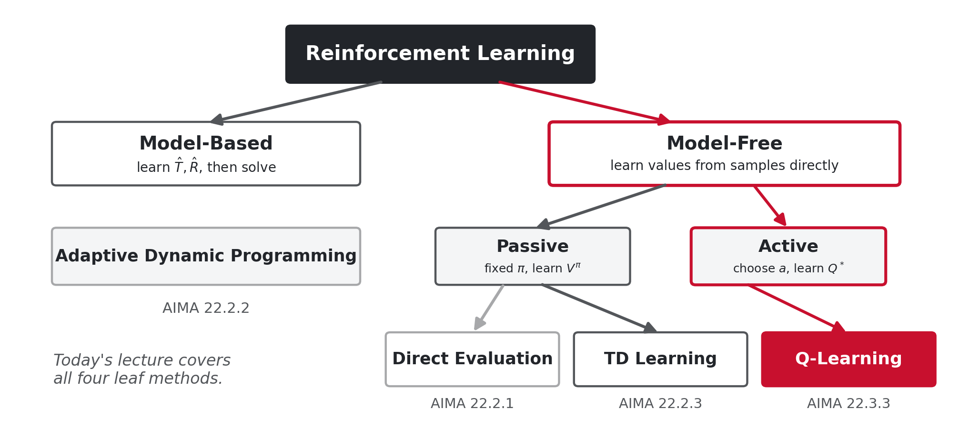
Two families, four algorithms
Every method today is one of the four leaves. We build them left to right.
Neither family dominates the other, but model-free methods are what almost everyone actually deploys.
COMP 469 · Reinforcement Learning I · CSU Channel Islands
15
Notes:
[2 min] Give the map before the details so students can place each algorithm as it arrives. Model-based is built first because it reuses everything from last lecture: learn the MDP, then solve it with value iteration. It is the stepping stone, not the destination. Within model-free, the passive/active split is about who chooses the actions. Passive means a fixed policy is handed to you and you evaluate it. Active means you choose, and you are after the optimal policy. Say plainly why model-free wins in practice: the model can be enormous and irrelevant. To play well you need to know which moves are good, not the full distribution over outcomes.

Slide 16
CHECKPOINT 1
Before we build anything
Take two minutes with the person next to you. Be ready to defend an answer.
A friend says: 'RL is just value iteration where you estimate T first.' What does that description leave out?
A
Your agent has visited state s exactly once, took action a, and landed in s'. What can you legitimately conclude about T(s, a, s')?
B
Give an example from your own field where the reward you can measure is not the behaviour you actually want.
C
Answers on the next slide. Question B is the one people get wrong.
COMP 469 · Reinforcement Learning I · CSU Channel Islands
16
Notes:
[4 min including discussion · OPTIONAL, cut this first if you are behind] Let them actually talk. Two minutes of pair discussion, then cold-call two or three groups. Expected wrong answer to B: 'T(s,a,s') = 1'. That is the maximum-likelihood estimate from one sample, and it is technically what counting gives you - but it is nearly worthless. Push on the difference between an estimate and a trustworthy estimate. Question C is the one that gets the room talking. Expect answers about metrics gaming, ticket-closure rates, click-through, standardised test scores.

Slide 17
CHECKPOINT 1
Answers
A
It leaves out the entire model-free branch.
Model-free methods never estimate T at all. They estimate values directly from sampled returns, and those are the methods that scale. The description also hides the harder question of how you get the experience in the first place.
B
Almost nothing, and the maximum-likelihood estimate is misleading.
Counting gives T(s, a, s') = 1, which asserts the transition is deterministic on the strength of one trial. With a single sample you cannot distinguish a certain outcome from an 80 percent one. This small-sample fragility is the first real problem with model-based learning.
C
Every measurable proxy eventually gets optimised instead of the goal.
Tickets closed rather than problems solved, patches applied rather than risk reduced, alerts triaged rather than intrusions found. The agent is not cheating; it is doing exactly what was written down.
COMP 469 · Reinforcement Learning I · CSU Channel Islands
17
Notes:
[2 min · OPTIONAL, cut this first if you are behind] Answer B is the pivot into the next section. Say it explicitly: the weakness they just identified in a one-sample estimate is precisely the first of four problems with model-based learning, and we are about to build the method anyway so they can see it fail on its own terms.

Slide 18
3
AIMA 22.2.2
Model-based learning
If you knew the MDP you could already solve it. So go and find out which MDP you are in.
COMP 469 · Reinforcement Learning I · CSU Channel Islands
18

Slide 19
The idea in two steps
1
Learn an empirical MDP
2
Solve it as if it were correct
For every (s, a) you have tried, count which s' you landed in.
Normalise those counts into an estimated transition model T̂(s, a, s').
Record each reward R̂(s, a, s') the first time you are paid it.
Hand T̂ and R̂ to value iteration, exactly as in the last lecture.
Nothing about the solver changes. It cannot tell the difference.
Re-solve periodically as more experience refines the estimates.
T̂(s, a, s') = count(s, a, s') / count(s, a)
This is maximum likelihood estimation followed by planning. AIMA calls it adaptive dynamic programming.
COMP 469 · Reinforcement Learning I · CSU Channel Islands
19
Notes:
[2 min] The pitch is genuinely appealing and you should sell it before you attack it: we already know how to solve MDPs, so the only missing piece is the MDP itself. Go get it. Note the asymmetry between T and R. Transitions are stochastic and need counting. Rewards in most course problems are deterministic given (s, a, s'), so one observation pins them down. If rewards were noisy you would average them the same way. Flag the recompute cost now: value iteration over the whole state space, run again every time the model updates. On a large problem that is expensive, and it is one reason people reach for model-free methods.

Slide 20
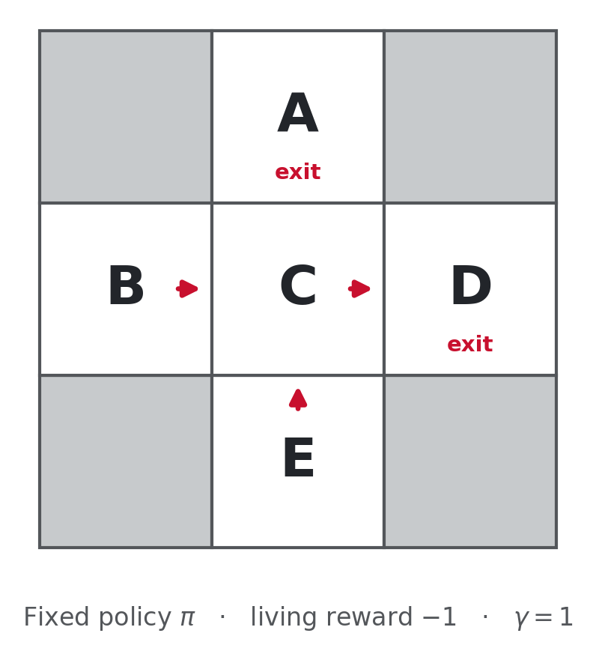
The running example
We will use this five-state grid for model-based learning, direct evaluation, and TD learning.
States
A, B, C, D, E. The grey squares are walls.
Fixed policy π
B goes east, C goes east, E goes north, A and D exit.
Living reward
−1 for every move you make.
Exits
D pays +10. A pays −10.
Discount
γ = 1, so no discounting. Returns are plain sums.
Stochastic?
Yes. C going east does not always reach D.
COMP 469 · Reinforcement Learning I · CSU Channel Islands
20
Notes:
[2 min] Spend the time here so you never have to re-explain the layout. Every worked example for the next forty minutes lives on this grid. The single most important line is the last one. C going east is stochastic - sometimes it slips to A. That is what makes this an MDP rather than a graph, and it is why one episode through C is not enough to know what C is worth. Note that the policy is given to us. We are not choosing actions yet. That is the passive setting and it holds until the Q-learning section.

Slide 21
Four observed episodes
The agent executes π and we take notes. This is the entire training set.
Episode 1
Episode 2
Episode 3
Episode 4
B, east, C
−1
B, east, C
−1
E, north, C
−1
E, north, C
−1
C, east, D
−1
C, east, D
−1
C, east, D
−1
C, east, A
−1
D, exit, x
+10
D, exit, x
+10
D, exit, x
+10
A, exit, x
−10
fell into the pit
Notice episode 4. The agent took the same action from C as in the other three episodes, east, and ended up somewhere else. That is the stochasticity, and it is the only reason this problem is interesting.
Twelve transitions total. Everything we learn today comes out of exactly these twelve tuples.
COMP 469 · Reinforcement Learning I · CSU Channel Islands
21
Notes:
[2 min] Walk episode 1 out loud, transition by transition, so the notation is unambiguous: state, action, next state, reward. Then contrast episodes 3 and 4. Identical opening, identical action from C, different landing state. Ask the class what that tells them - the answer you want is that C's east action is stochastic, and that no single episode could have revealed that. Count the transitions with them: 3 + 3 + 3 + 3 = 12. It is worth saying the number out loud because students imagine RL needs enormous data before anything can be computed, and we are about to compute a full model from twelve samples.

Slide 22
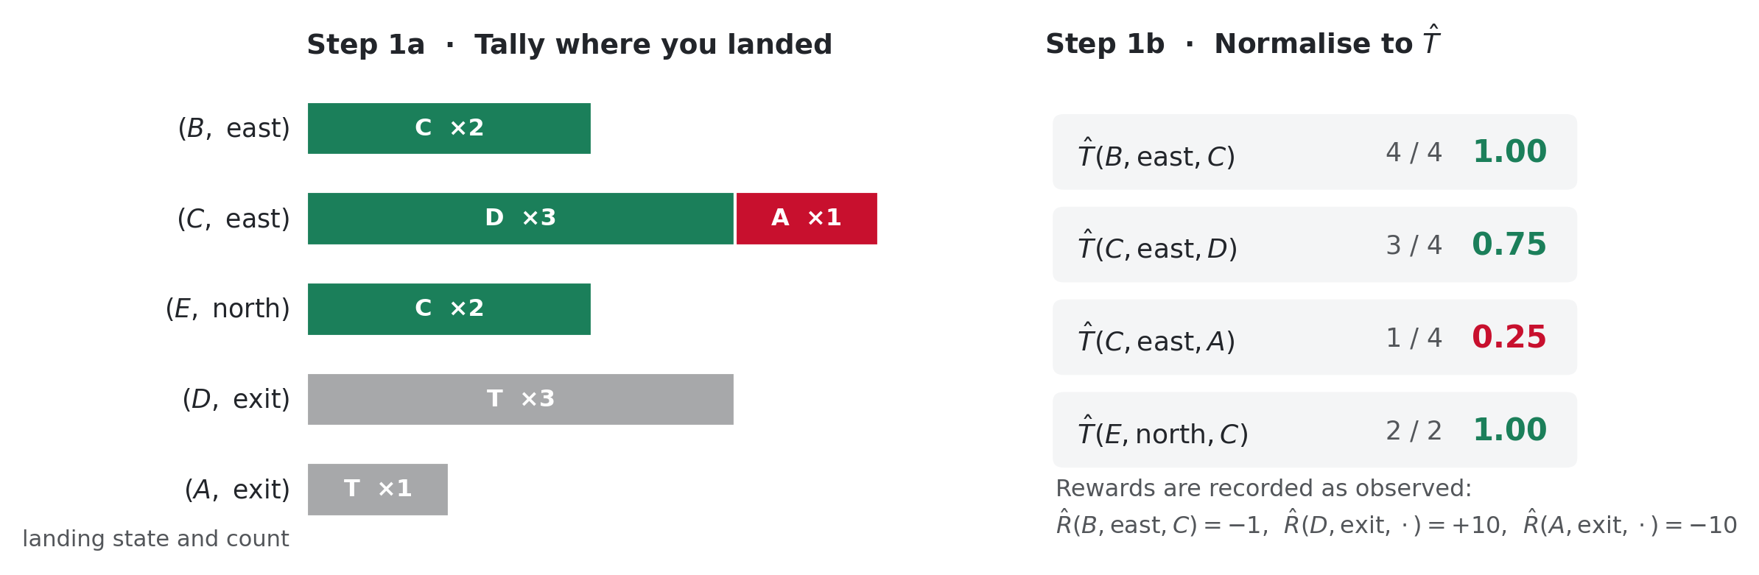
STEP 1
Count, then normalise
C took east four times: three landings in D, one in A. That single fraction is everything the model knows about C.
COMP 469 · Reinforcement Learning I · CSU Channel Islands
22
Notes:
[3 min] Do this one live rather than reading it. Ask the class to count with you: 'how many times did the agent take east from C?' Four. 'How many landed in D?' Three. So T-hat of D given C, east is three quarters. Then ask the sharper question: is the true transition probability 0.75? Almost certainly not. It is whatever the environment's real parameter is - probably 0.8 in a standard gridworld. Four samples gave us 0.75. That gap is sampling noise and it does not go away by wishing. Point at B: T-hat of C given B, east equals 1.00 from two samples. The model now asserts this transition is deterministic. It might be, or we might have been lucky twice. The model has no way to express its own uncertainty, which is a real limitation.

Slide 23
STEP 2
Hand the learned model to value iteration
Nothing about the solver changes. It runs the same Bellman update it always did, on estimates rather than on truth.
Vₖ₊₁(s) ← maxₐ Σₛ' T̂(s, a, s') [ R̂(s, a, s') + γ Vₖ(s') ]
What this buys you
What it costs
Uses every observed transition efficiently. Each sample updates the model, and the model informs every state.
Once T̂ is good, planning quality is as good as ordinary value iteration.
You can re-plan for a new reward function without collecting new experience.
You must store a full model: |S| × |A| × |S| numbers.
You must re-run a full solve every time the model changes materially.
Both costs scale with the state space, which is exactly what gets large.
Solving the learned MDP is the easy half. Getting a trustworthy model is the hard half.
COMP 469 · Reinforcement Learning I · CSU Channel Islands
23
Notes:
[2 min · OPTIONAL, cut this first if you are behind] The point to make is that step 2 is free intellectual work - we already did it last lecture. All the difficulty in model-based RL lives in step 1. The third bullet under 'what this buys you' is underappreciated and worth calling out: because you have an explicit model, you can change the reward function and re-plan without collecting a single new sample. Model-free methods cannot do that - they would have to relearn from scratch. That is a genuine advantage and the main reason model-based methods are still researched hard. The storage line lands well with this cohort if you make it concrete: a modest problem with 10,000 states and 4 actions needs 400 million transition entries.

Slide 24
Four things wrong with model-based learning
Small-sample noise
Estimates built from a handful of visits can be badly wrong, and there are a lot of (s, a) pairs to cover.
1
No coverage guarantee
States the given policy never visits are simply blank. Nothing here ensures the experience stream covers what you need.
2
Real consequences
You are not in a simulator. A badly estimated action can collect a large negative reward for real. Fine for card games, expensive for drones.
3
No way to go get data
If you decide you need better statistics at C, this framework has nothing to say about how to get back to C. It describes learning from experience, not seeking it.
4
Problem 4 is the one we cannot fix today. It becomes the exploration problem, and it is where this lecture ends.
COMP 469 · Reinforcement Learning I · CSU Channel Islands
24
Notes:
[3 min] Run this as discussion rather than exposition. Ask 'what could go wrong here?' and let them generate the list; they will usually find 1 and 3 on their own, sometimes 2, almost never 4. Problem 2 deserves a concrete instance: under this fixed policy the agent never goes west from B. So the model has no entry at all for (B, west). Value iteration on that model will happily produce a policy that is optimal for a world where west does not exist. Problem 4 is the deepest and the one to leave hanging. Every algorithm today describes what to do with experience once it arrives. None of them says how to steer the agent toward the experience it most needs. That gap is next lecture.

Slide 25
4
AIMA 22.2
Model-free learning
You do not need a distribution to compute an average. You only need samples.
COMP 469 · Reinforcement Learning I · CSU Channel Islands
25

Slide 26
A DETOUR WORTH TAKING
Expected age of a COMP 469 section
Forget MDPs for four minutes. Suppose I want the average age of the people in this room. There are two honest ways to get it, and the difference between them is the difference between the two halves of this lecture.
If I already knew P(age)
a weighted average, and I need the weights
E[A] = Σₐ P(a) · a = 0.35 × 20 + 0.25 × 21 + …
But I do not know P(age). All I can do is go around the room and ask. That gives me a stream of raw samples:
[ a₁, a₂, a₃, …, aₙ ]
Model-based
Model-free
Use the samples to estimate the distribution, then compute the expectation from it.
Skip the distribution entirely. Just average the numbers as they arrive.
P̂(a) = num(a) / N E[A] ≈ Σₐ P̂(a) · a
E[A] ≈ (1/N) Σᵢ aᵢ
COMP 469 · Reinforcement Learning I · CSU Channel Islands
26
Notes:
[3 min] This detour is the conceptual centre of the lecture. Do not hurry it, and do not let students dismiss it as obvious. Actually do it live if the room is small enough: ask four or five students their age and write the numbers on the board. Then ask the class which of the two boxes they would use. Almost everyone says average the numbers, because it is obviously the sane thing to do. Then make the point that will pay off for the next hour: nobody in this room would build a histogram of ages first. But that is exactly what model-based RL does. Estimate the distribution, then take the weighted average against it. Set up the next slide by asking WHY the right-hand box works. Do not answer yet.

Slide 27
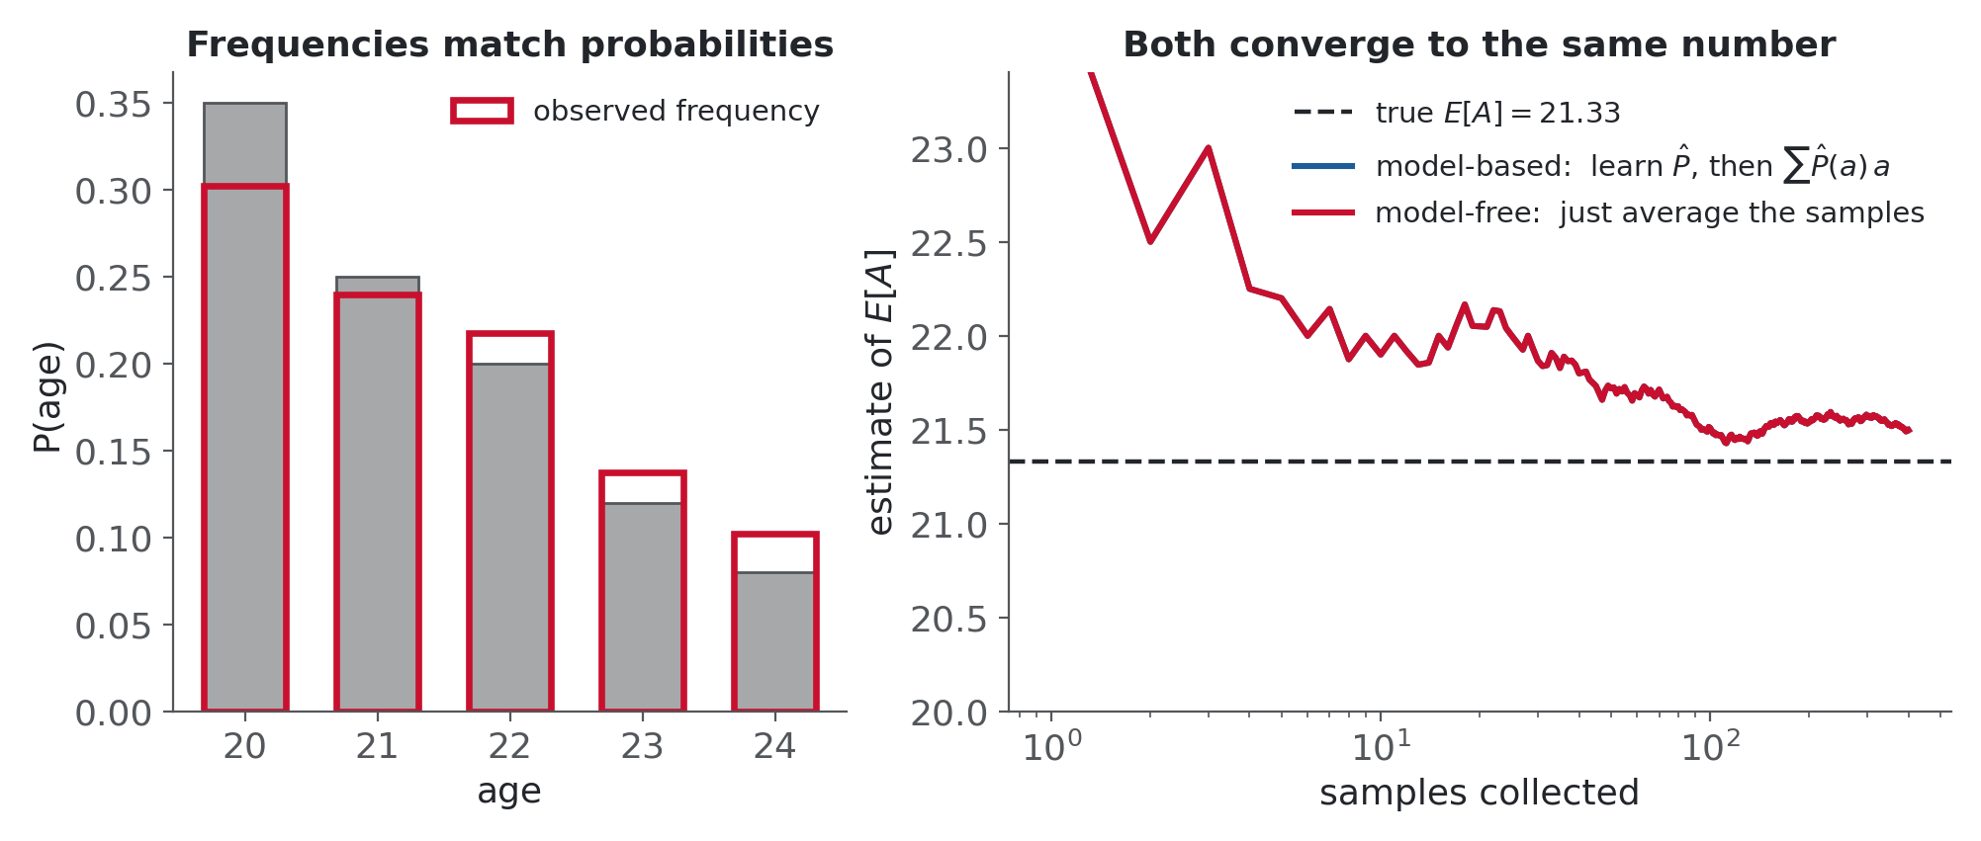
Why averaging raw samples gets the same answer
Model-based works because
Model-free works because
eventually you learn the right distribution, and then the weighted average is correct by construction.
samples arrive with the right frequencies. A value twice as likely shows up twice as often, so an unweighted average of the stream already carries the weights.
COMP 469 · Reinforcement Learning I · CSU Channel Islands
27
Notes:
[2 min] The sentence to get exactly right: probability shows up as frequency. You never have to write the probability down because the sampling process already applied it for you. Point at the left panel of the figure. The grey bars are the true distribution, the red outlines are what 400 samples actually delivered. They line up, and nobody had to estimate anything to make that happen. Right panel: both estimators converge to the same 21.33. Model-based is slightly smoother early on, which is a genuine and general property - it can be more sample-efficient. But it needed to store and maintain a distribution to get there, and the model-free line needed one running number. If a student asks which is better: neither, and that is the honest answer. Model-free wins in practice because the model is often enormous and mostly irrelevant to acting well.

Slide 28
THE IDEA BEHIND EVERY REMAINING ALGORITHM
Any expectation you would have computed with a model can instead be computed as a running average of samples you actually observed.
Σₛ' T(s, a, s') · [ … ]
→
running average of [ … ] as it happens
needs the weights
needs nothing but experience
Direct evaluation, TD learning, and Q-learning are three different answers to the question of which expectation to replace and when to update.
COMP 469 · Reinforcement Learning I · CSU Channel Islands
28
Notes:
[2 min] Slow down. Read the big sentence aloud, then pause. Tell students explicitly: if you retain one sentence from this lecture, retain that one. Everything from here is bookkeeping about which average to take and how often to update it. Preview the three answers so the structure is visible in advance: - Direct evaluation averages whole returns, one per visit, at the end of the episode. - TD learning averages one-step samples, immediately, on every transition. - Q-learning does the same but on state-action pairs, which turns out to solve the control problem as well. Then move. Do not over-explain a slide whose job is to be memorable.

Slide 29
5
AIMA 22.2.1
Passive RL and direct evaluation
Simplify twice so the learning mechanics can be seen clearly, then watch the simplest possible method waste most of its data.
COMP 469 · Reinforcement Learning I · CSU Channel Islands
29

Slide 30
Passive reinforcement learning
Two simplifications, made on purpose, so that one thing is happening at a time.
You do not choose actions
1
The learner is along for the ride. Some policy is being executed and the learner takes notes. Choosing what to try, and the explore-versus-exploit problem that comes with it, is deferred.
The policy is fixed
2
We are learning Vπ(s), the value of s under one specific given policy. Not V*(s). This is policy evaluation, not control. Learning optimal behaviour is the harder problem we reach in the Q-learning section.
This is still not offline planning.
The agent is genuinely out in the world taking actions and being paid. It simply is not the one deciding which actions those are.
Input: a fixed π. Unknown: T and R. Goal: the state values under that π.
COMP 469 · Reinforcement Learning I · CSU Channel Islands
30
Notes:
[2 min] The distinction students lose is between policy evaluation and control. Say it three different ways. Policy evaluation: here is a policy, how good is it? Control: find me a good policy. Today's first half only does evaluation, and the second half does control. The red box exists because students hear 'fixed policy, just watching' and mentally file it under planning. It is not. The transitions are real, the rewards are real, the pit is real. The only thing that has been taken away is the agent's freedom to choose. Analogy that works: a new analyst shadowing an experienced one. They are not making the decisions, but they are in the room and the incidents are real.

Slide 31
Direct evaluation
The simplest thing that could possibly work, stated in three lines.
Act according to π.
1
Every time you visit a state, write down the total discounted reward that actually arrived from that point until the episode ended.
2
Average those totals across every visit to that state.
3
Vπ(s) ≈ average over visits to s of [ rₜ + γ rₜ₊₁ + γ² rₜ₊₂ + … ]
That is the whole algorithm. AIMA calls it direct utility estimation; you will also see it called Monte Carlo evaluation. It is correct in the limit, and essentially nobody uses it.
COMP 469 · Reinforcement Learning I · CSU Channel Islands
31
Notes:
[2 min] Emphasise the word 'total' in step 2. This is the single most common error when students do it by hand: they write down the immediate reward, or the final reward, instead of the sum of everything from that point on. Say the definition of a return out loud and make them repeat the structure: the sample value of a state on one visit is the sum of all rewards received from that visit to the end of the episode. The last line is deliberately provocative. Let it sit. We are going to build the method carefully and then show exactly why it is abandoned - that sequence teaches better than skipping it.

Slide 32
WORKED BY HAND
Computing returns from episode 1
Episode 1 was B → C → D → exit, paying −1, −1, and +10. Each state's sample is the sum of everything from that state onward, with γ = 1.
B
−1 + −1 + +10
=
+8
everything that happened after arriving at B
C
−1 + +10
=
+9
the first −1 is already spent and does not count against C
D
+10
=
+10
only the exit reward remains
The trap
V(B) is not −1, and it is not +10. A state is worth the whole future that follows it, not the next reward and not the last one.
COMP 469 · Reinforcement Learning I · CSU Channel Islands
32
Notes:
[3 min] Do this on the board with them, not off the slide. Ask for V(B) before revealing it and expect to hear both −1 and +10 from the room. The C row carries the subtlety worth dwelling on: the first −1, the step that got the agent from B to C, does not appear in C's return. It was paid before arriving. A state's value is about the future, and past costs are sunk. If gamma were less than 1, note that each term would be discounted by its distance: r + gamma r' + gamma squared r''. Here gamma is 1 so the arithmetic stays clean, which is exactly why the example is set up this way.

Slide 33
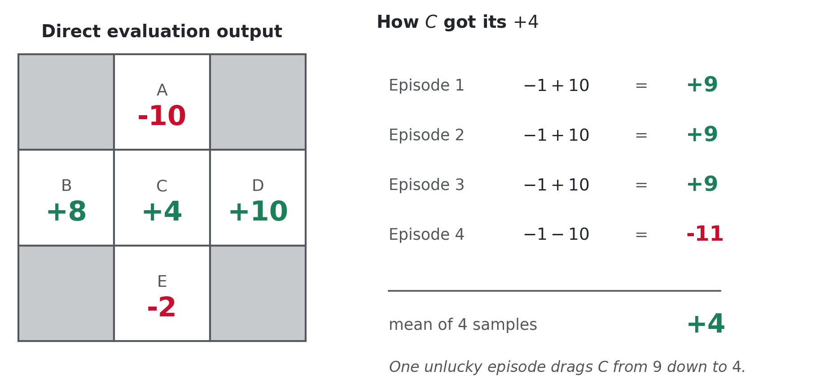
All four episodes, averaged
Each state's estimate is the mean of its observed returns.
C was visited four times: 9, 9, 9, and −11. One unlucky episode pulls its estimate down to +4.
COMP 469 · Reinforcement Learning I · CSU Channel Islands
33
Notes:
[3 min] Walk the states in order of difficulty. A was visited once and returned −10. B was visited twice, both times returning +8. D returned +10 three times. Those are easy. C is where the lesson is. Three episodes went through D and returned 9. The fourth slipped to A: a −1 living reward plus a −10 pit, so −11 for that episode. Mean of 9, 9, 9, −11 is 16 over 4, which is +4. E is worth one extra beat because students miscompute it. Two visits: episode 3 returned −1 −1 +10 = 8, episode 4 returned −1 −1 −10 = −12. Mean is −2. Now set the hook for the next slide: ask whether anything about these five numbers looks wrong. Do not answer. Advance.

Slide 34
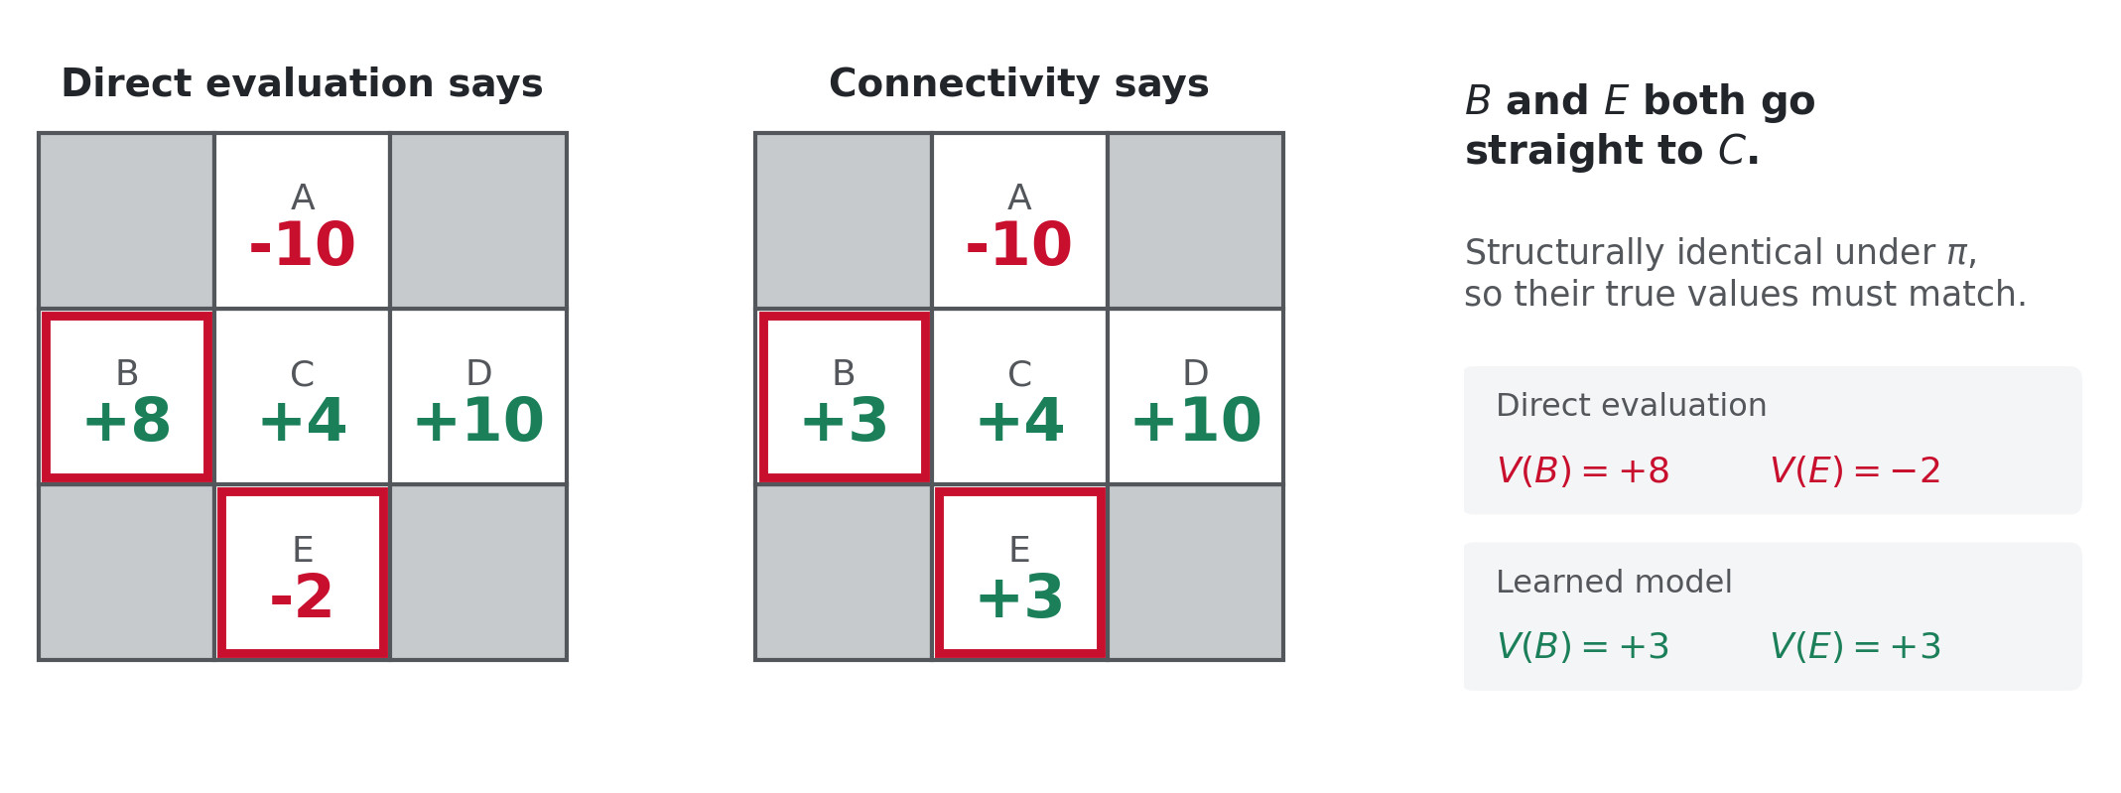
THE PROBLEM
B and E cannot possibly have different values
Under this policy B and E both go straight to C, so they must be worth the same. Direct evaluation reports +8 and −2.
COMP 469 · Reinforcement Learning I · CSU Channel Islands
34
Notes:
[4 min] This is the most important slide in the first half. Give it room. Establish the structural fact first: under this policy, B goes east to C and E goes north to C. Both land in C with a −1 step. Whatever C is worth, B and E are worth exactly one step less than it. They cannot differ. Direct evaluation reports +8 and −2, a fourteen-point spread, purely because B's two episodes happened to avoid the pit and one of E's did not. The right panel is the one to make them look at. If you take the model we learned earlier and simply evaluate the policy on it, you get V(B) = V(E) = 3, and C = 4. Those numbers are consistent with each other. That is what using the connectivity buys you. State the diagnosis plainly: direct evaluation treats every state as an independent estimation problem. It never uses the fact that B leads to C. So everything it learns about C has to be relearned from scratch for B.

Slide 35
Direct evaluation, scored honestly
Where it holds up
Where it fails
It is genuinely simple. You can implement it in ten lines.
It requires no knowledge of T or R. They are implicit in the observed rewards.
It converges to the correct values eventually, for exactly the reason the age example did: it is averaging samples.
It is unbiased. No bootstrapping means no error inherited from other estimates.
It throws away every fact about how states connect to each other.
Each state must be learned separately, from its own independent visits.
Every sample absorbs the variance of the entire rest of the episode, most of which is irrelevant noise once you know the next state's value.
So it needs far more experience than necessary to reach the same accuracy.
The fix is not a better averaging scheme. The fix is to stop ignoring that B leads to C.
COMP 469 · Reinforcement Learning I · CSU Channel Islands
35
Notes:
[2 min · OPTIONAL, cut this first if you are behind] The unbiasedness point in the left column is worth stating because it is the one real advantage direct evaluation retains, and a sharp student may raise it later when we discuss TD. TD learning bootstraps: it updates one estimate using another estimate, which introduces bias early on. Direct evaluation never does, so it is unbiased but high variance. TD is biased but low variance. That bias-variance trade is the real comparison, and in practice the variance reduction wins decisively. Do not go deeper than that today. Just plant the vocabulary.

Slide 36
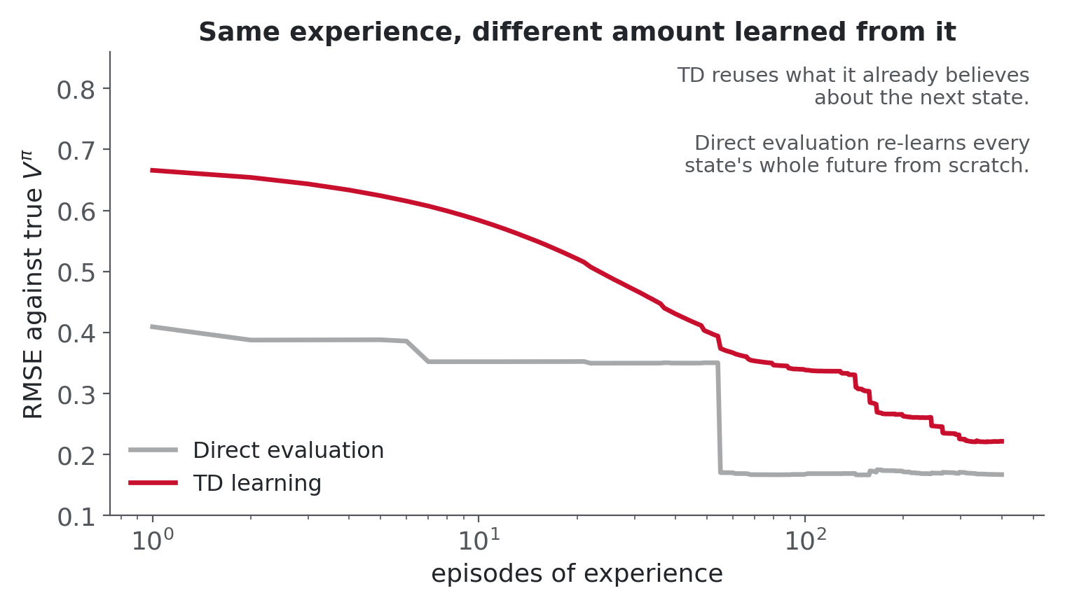
What that waste costs in practice
Identical experience, both methods evaluating the same fixed policy on the same gridworld.
Direct evaluation is not wrong. It is slow, and slow is fatal when every sample costs a real action in a real world.
COMP 469 · Reinforcement Learning I · CSU Channel Islands
36
Notes:
[2 min · OPTIONAL, cut this first if you are behind] This figure is generated from an actual run, not drawn by hand. Both methods see the same episodes from the same seed. Read the axes for them: horizontal is episodes on a log scale, vertical is root mean squared error against the true values computed by value iteration. Be honest about what the curves show. Direct evaluation starts lower - it is unbiased, so with very little data it is not systematically off. TD starts worse because it is bootstrapping off estimates that are all still zero. Then TD keeps improving as the estimates feed each other, which is the connectivity paying off. The honest summary is the keyline: the issue is sample cost. In a simulator you might not care. On hardware, every episode is a real trial with real wear and real risk.

Slide 37
10
So far
RL is an MDP with T and R withheld
Break
Model-based: learn T̂ and R̂, then solve
Averaging samples replaces an expectation
Back in ten minutes. When we return we stop averaging whole episodes and start learning from every single transition.
Direct evaluation works but wastes the structure
COMP 469 · Reinforcement Learning I · CSU Channel Islands
37
Notes:
[10 min] Roughly the sixty-minute mark if you have kept pace. Before you break, leave one question on the board for them to chew on: we know B leads to C, and we have an estimate for C. How could B use that estimate directly instead of waiting to watch its own episodes play out? That is the TD update, and if anyone works it out over the break the second half writes itself. Leave the crawler applet running through the break.

Slide 38
6
AIMA 22.2.3
Temporal difference learning
Stop waiting for the episode to finish. Learn something from every single transition.
COMP 469 · Reinforcement Learning I · CSU Channel Islands
38

Slide 39
RECALL FROM LAST LECTURE
Policy evaluation, when you have the model
Vₖ₊₁π(s) ← Σₛ' T(s, π(s), s') [ R(s, π(s), s') + γ Vₖπ(s') ]
starting from V₀π(s) = 0 everywhere.
One step of lookahead is enough
The new estimate at s is built from the old estimate at s', one step away. You never unroll the whole rest of the episode.
Connectivity does the work
Everything already believed about C automatically improves B, because B's update reads C's number. This is exactly what direct evaluation discarded.
But it needs T and R
The weights in that sum and the reward inside the bracket are precisely the two things RL does not have.
The central question of RL: can we run this update without knowing T and R?
COMP 469 · Reinforcement Learning I · CSU Channel Islands
39
Notes:
[2 min] Reconnect this to the B and E failure they just saw. The property in the second green row is the exact thing direct evaluation lacked. Say the structural insight cleanly: this update reads a number from one step away and does not care what happens after that. The value of s' already summarises the entire future beyond it. That is the whole point of a value function. Then land on the keyline as a genuine question. We have exactly one tool for removing a model - replace an expectation with a running average of samples. Ask them where the expectation is in this formula. It is the sum over s' weighted by T. That is the thing we are going to sample.

Slide 40
FIRST ATTEMPT
Sample the outcomes and average them
We cannot compute the weighted sum, so take samples of the outcome by actually doing the action, and average them.
sample₁ = R(s, π(s), s'₁) + γ Vₖπ(s'₁)
sample₂ = R(s, π(s), s'₂) + γ Vₖπ(s'₂)
…
sampleₙ = R(s, π(s), s'ₙ) + γ Vₖπ(s'ₙ)
Vₖ₊₁π(s) ← (1/n) Σᵢ sampleᵢ
Almost. But you cannot rewind time.
Once you take π(s) from s you land somewhere and you are off. Getting a second sample from that same s means waiting until you happen to return, and while you wait you are incorporating nothing. Samples do not arrive in neat batches from one state; they trickle in scattered across wherever the agent goes.
COMP 469 · Reinforcement Learning I · CSU Channel Islands
40
Notes:
[2 min] Present the idea as if it works, let them nod along, then break it. The formula is right. That is the frustrating part. If you could stand in state s and take the same action fifty times, averaging those samples would give you exactly the Bellman update with no model at all. The obstacle is not mathematical, it is physical. You get one sample per visit and then you are somewhere else. Ask the class what they would do - the answer you are steering toward is: stop batching, update on every single sample as it arrives. That reframe is the entire content of the next slide.

Slide 41
Temporal difference learning
Learn from every experience, immediately, one sample at a time.
Given a single observed transition (s, a, s', r):
Sample of V(s)
sample = r + γ Vπ(s')
Update to V(s)
Vπ(s) ← (1 − α) Vπ(s) + α · sample
Same update, rearranged
Vπ(s) ← Vπ(s) + α ( sample − Vπ(s) )
The third form is the one to remember.
The bracket is the temporal difference: how far off your old belief turned out to be. No surprise means no update.
Policy is still fixed. This is still evaluation, not control.
COMP 469 · Reinforcement Learning I · CSU Channel Islands
41
Notes:
[3 min] Show algebraically that forms two and three are identical - expand the third and the V terms collect. Students who have seen gradient descent recognise the third form instantly as a step proportional to an error. Two things to nail down: 1. The sample uses V of s prime, the CURRENT estimate of the landing state. It is a guess, and early on it is a bad guess. TD bootstraps off its own estimates and it still works. 2. Likely outcomes contribute updates more often, purely because they happen more often. The weighting by T comes back for free through frequency, exactly as in the age example. Remind them the policy is still fixed. Students start believing TD solves control at this point and it does not.

Slide 42
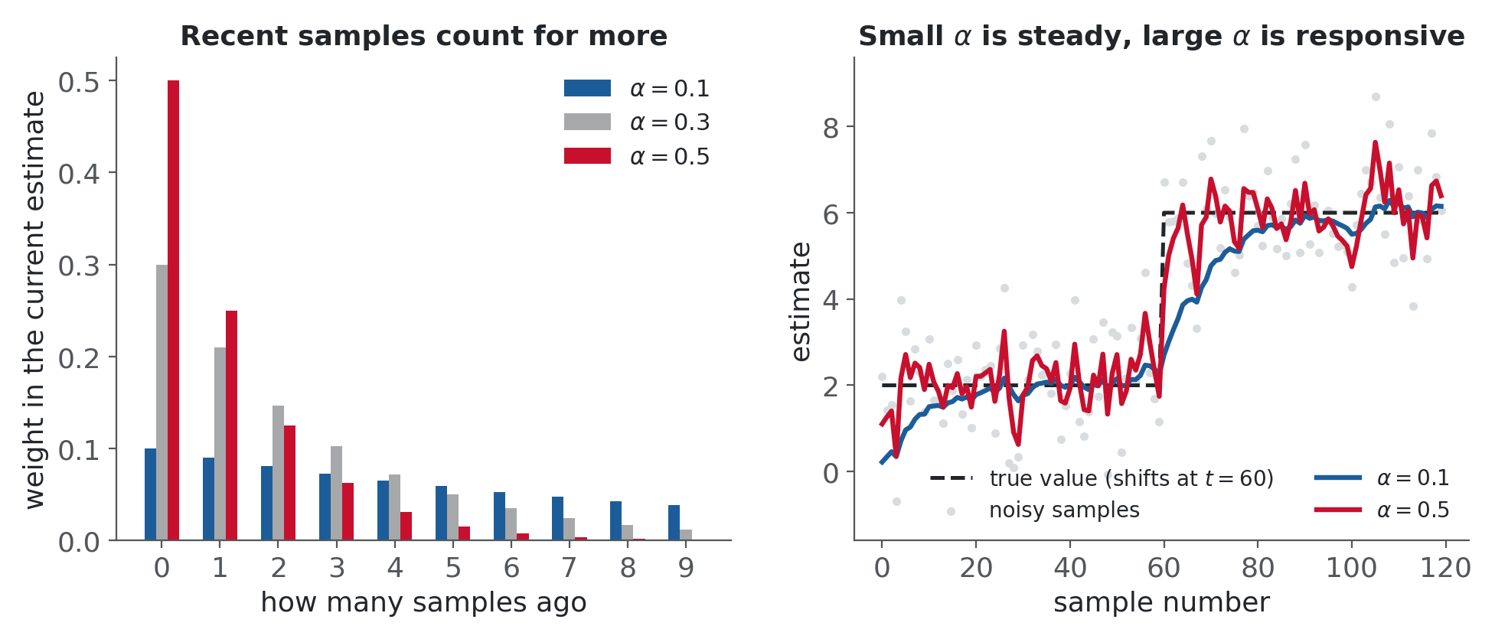
This is an exponential moving average
Repeatedly interpolating toward each new sample weights recent experience more heavily.
Old samples decay by (1 − α) each step
Which is correct, not a bug: old samples were computed against older, worse estimates of the downstream states
Small α is stable but slow. Large α tracks change but stays noisy
Decreasing α over time gives convergence
COMP 469 · Reinforcement Learning I · CSU Channel Islands
42
Notes:
[2 min] The second bullet is the insight, and it is genuinely non-obvious. Students initially read the forgetting as a defect. Argue it properly: a sample taken 200 transitions ago used whatever V(s') was believed at that time, and that belief was worse than the current one. So the old sample is contaminated by an old estimate, and discounting it is correct. Right-hand panel: the true value jumps at sample 60. Alpha of 0.1 crawls to the new level, alpha of 0.5 gets there fast but rattles. That is the whole stability-versus-responsiveness trade in one picture. For Project 3 tell them 0.1 to 0.5 is the practical range, and that the convergence guarantee needs alpha to shrink but not too fast. We show that failing empirically later in the lecture.

Slide 43
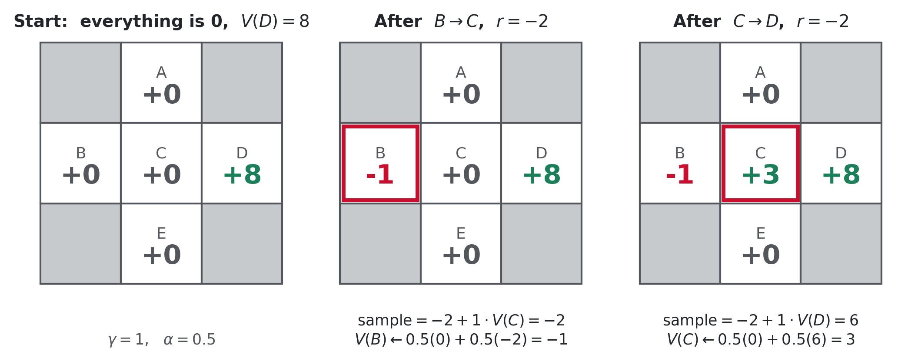
WORKED BY HAND
Two transitions, two updates
Each update touches exactly one state, and only the state the agent just left.
COMP 469 · Reinforcement Learning I · CSU Channel Islands
43
Notes:
[5 min] The single most important worked example in the lecture. Do it slowly on the board alongside the slide. Setup: gamma 1, alpha 0.5, everything believed to be 0 except D which is already believed to be 8. Transition one, B east to C with reward −2. We are learning about B. Old estimate 0. Sample is −2 plus 1 times V(C), and V(C) is still 0, so the sample is −2. New V(B) is half of 0 plus half of −2, which is −1. Sanity check it aloud: B looked worth 0, we paid 2 to reach a state that still looks worthless, so B should drop. It did. Transition two, C east to D with reward −2. Now we learn about C. Old estimate 0. Sample is −2 plus V(D) which is 8, so 6. New V(C) is half of 0 plus half of 6, which is 3. Again check the direction: C looked neutral, this transition revealed it leads toward the good exit, so it should rise. It did. Ask why V(B) did not become 3 as well. It cannot yet - B's update happened before C knew anything. B improves the next time it is visited. That delay is the backward propagation we will see explicitly in the Q-learning demo.

Slide 44
EASY TO GET WRONG
You update the state you left, never the one you land in
Arriving somewhere tells you nothing about that place. You have not done anything there yet. The reward and the transition you just observed are evidence about where you came from.
s
→
a, r
→
s'
updated
observed
read, never updated
V(s') is read only, to build the sample. The transition is evidence about s.
You leave learning in your wake.
Each transition improves exactly one number, and it is behind you.
Values therefore propagate backward, one state per visit.
Good news near the exit takes several passes to reach the start, because each pass moves it one step.
This is why early episodes look like nothing is happening.
Until some state has a nonzero value, every sample is zero plus zero, and every update is a no-op.
COMP 469 · Reinforcement Learning I · CSU Channel Islands
44
Notes:
[2 min] Students break this rule constantly on exams, updating the landing state instead of the departure state. Say it, show it, and say it again. The last pair of bullets pre-empts a question that always comes up during Project 3: 'my agent ran two hundred steps and every Q-value is still zero, is it broken?' No. Until the first reward is actually collected there is nothing to propagate. The first nonzero value appears at the goal and then crawls outward. Tell them that explicitly now and you will save yourself the office-hours traffic later.

Slide 45
CHECKPOINT 2
Do one by hand
Two minutes. Same grid, γ = 1, α = 0.5. Current estimates are shown.
Current estimates
1
Which state's value changes?
V(B)
V(C)
V(D)
V(E)
−1
+3
+8
0
2
What is the sample?
Observed transition: E, north, C, reward −1
What is the new estimate for that state?
3
4
Would your answer to 1 change if the reward had been +100?
Answers
1. E, the state we left. C is only read.
2. sample = −1 + 1 × V(C) = −1 + 3 = +2
3. V(E) ← 0.5 × 0 + 0.5 × 2 = +1
4. No. The reward changes the sample, never which state gets updated.
E rose from 0 to +1 without ever seeing the exit, purely by borrowing C's estimate.
COMP 469 · Reinforcement Learning I · CSU Channel Islands
45
Notes:
[4 min] Cover the answer box with a blank sheet, or animate it in, and give them the two minutes for real. Question 4 is the diagnostic. If they say yes, they have not internalised the rule from the previous slide. The keyline is the payoff and worth saying twice: E never went to D, never saw the +10, and its value still improved. Direct evaluation could not have done that - it would have had to wait for E's own episode to finish. This is the connectivity working, and it is the entire reason TD beats direct evaluation.

Slide 46
7
AIMA 22.3.3
Q-learning
Learning values was never the goal. Choosing actions was. That takes one more idea.
COMP 469 · Reinforcement Learning I · CSU Channel Islands
46

Slide 47
THE PROBLEM WITH WHAT WE JUST BUILT
TD gives you Vπ. It does not give you a policy.
TD learning is a model-free way to do policy evaluation. But the moment you want to turn those values into a better policy, you are stuck.
π(s) = arg maxₐ Q(s, a)
Q(s, a) = Σₛ' T(s, a, s') [ R(s, a, s') + γ V(s') ]
Read the second line carefully.
To pick an action from state values you have to score each action, and scoring an action means computing its Q-value. That computation needs T and R. So even with a perfect Vπ in hand, action selection still requires exactly the model that reinforcement learning does not have.
We removed the model from evaluation and it came straight back in at decision time.
COMP 469 · Reinforcement Learning I · CSU Channel Islands
47
Notes:
[3 min] This is a genuine dead end and it should feel like one. Do not rush to the fix. Make the circularity explicit: RL exists because we do not have T and R. TD learning triumphantly evaluates a policy without them. Then the very first thing you want to do with that evaluation - improve the policy - needs T and R again. Historical context is worth the minute. This is roughly where reinforcement learning sat for a long stretch. People knew how to evaluate a given policy from experience. Nobody knew how to use that to choose actions or learn optimal behaviour. The field could describe how good your current habits were and could not tell you how to change them. Set up the obvious next question: why not just apply the same sampling trick to value iteration, which computes V star rather than V pi?

Slide 48
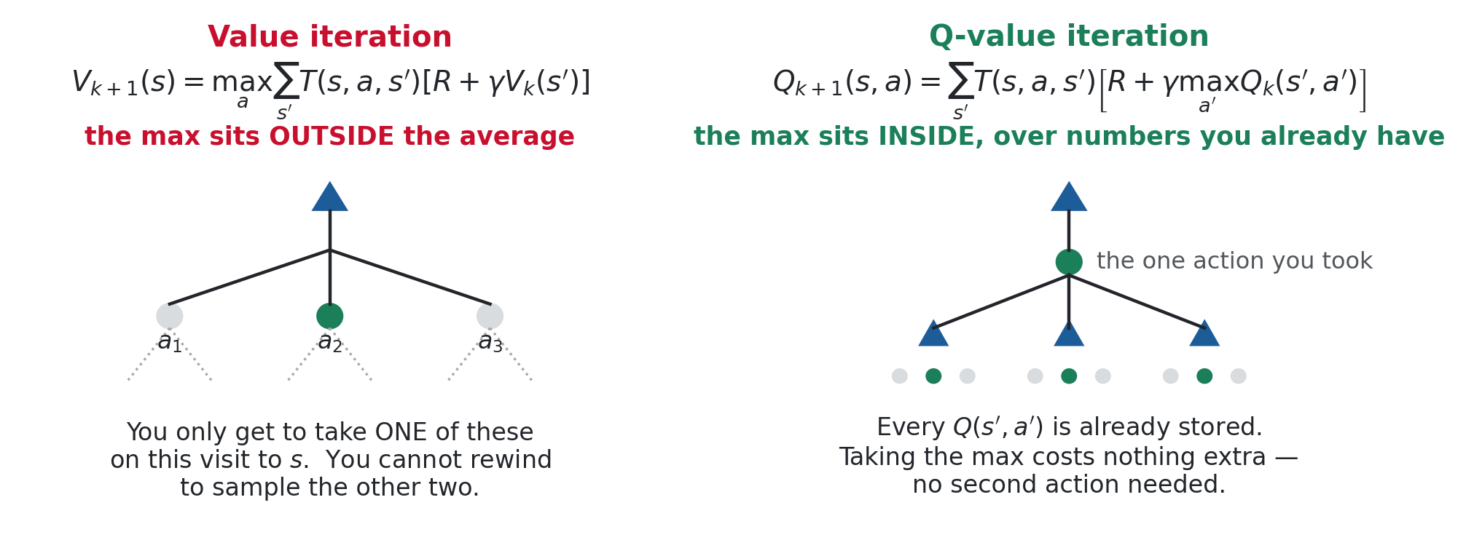
THE OBVIOUS FIX, AND WHY IT FAILS
The max is standing in the way
Under a fixed π there was no max to worry about. Chasing optimal values puts one in front of the average.
COMP 469 · Reinforcement Learning I · CSU Channel Islands
48
Notes:
[4 min] Work the left panel first and let the difficulty be felt. The sum over s prime is not the problem - we already know how to sample that. The problem is the max over a sitting outside it. To take a max over actions you need a value for every action, which means comparing what different actions would do from the same state. On any given visit to s you execute exactly one action and see one outcome. You cannot rewind and try the other two to compare. This blocked the field for a long time. Everyone knew they wanted this update and knew they wanted it as a running average, and the max was simply in the way. Now the right panel. Write the same dynamic programming update for Q-values instead, assuming for a moment the model is known, just to look at the shape. The max moved inside the bracket. The outer averaging over s prime is exactly the same kind of average as before, so it can be sampled. And the inner max is over Q-values you are already storing for every action out of s prime - computing it costs nothing, because you already maintain all those numbers. Say the punchline plainly: the choice of which action to bootstrap from became a free lookup instead of something requiring a second action in the same visit.

Slide 49
DETOUR
Q-value iteration
Same algorithm as value iteration, tracking one number per state-action pair instead of one per state.
Value iteration
V₀(s) = 0, which we know is right
Vₖ₊₁(s) ← maxₐ Σₛ' T(s, a, s') [ R + γ Vₖ(s') ]
Q-value iteration
Q₀(s, a) = 0, which we also know is right
Qₖ₊₁(s, a) ← Σₛ' T(s, a, s') [ R + γ maxₐ' Qₖ(s', a') ]
maxₐ' Qₖ(s', a')
is just another way of writing Vₖ(s'). The two formulations carry the same information; Q simply stores it broken out by action, which is what makes it usable.
COMP 469 · Reinforcement Learning I · CSU Channel Islands
49
Notes:
[2 min · OPTIONAL, cut this first if you are behind] The equivalence in the green box is worth pausing on. The best Q-value available at a state IS the value of that state. Nothing new is being tracked - it is the same information, indexed differently. So why bother? Because the indexing is what you need at decision time. With V you know how good states are and still cannot rank actions. With Q you read off the row for your current state and take the largest entry. Cost: you store |S| times |A| numbers instead of |S|. In a four-action gridworld that is four times the memory. That is the price of model-free action selection and it is a bargain.

Slide 50
Q-learning
Sample-based Q-value iteration. Take the update above and replace the expectation with a running average.
Receive a sample
(s, a, s', r)
1
Consider your old estimate
Q(s, a)
2
Form the new sample estimate
sample = r + γ maxₐ' Q(s', a')
3
Fold it into a running average
Q(s, a) ← (1 − α) Q(s, a) + α · sample
4
Action selection is now completely model-free: look at the Q-values leaving your state and take the largest. No T, no R, no lookahead.
COMP 469 · Reinforcement Learning I · CSU Channel Islands
50
Notes:
[3 min] Note that the deck's page counter is fine here; this is the algorithm slide students will photograph, so keep it clean and spend the time. Walk the four lines as a loop the agent runs forever. Emphasise that step three uses max over a prime, the best action available from the landing state, not the action the agent actually takes next. That distinction is the whole of the next slide and the source of the off-policy property. Point out what is being learned: one number per state-action pair. A gridworld cell with four moves is learning four Q-values simultaneously, even though only one of them corresponds to the eventual optimal action. The other three still get learned and still help along the way. Tell them this is the update they implement in Project 3, and it is about four lines of Python.

Slide 51
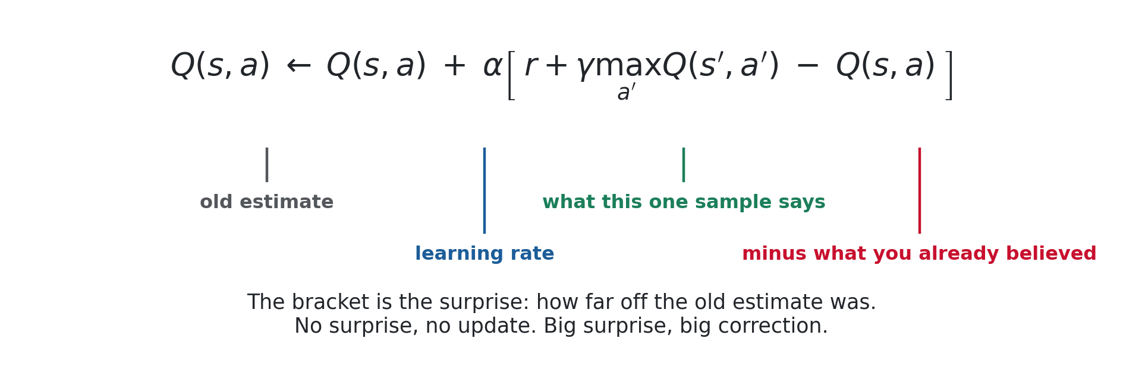
Anatomy of the update
Written as a correction rather than an interpolation, the same four lines read as a single idea.
If the sample matches your estimate
If the sample is higher
If the sample is lower
the bracket is zero and nothing moves.
the estimate rises by a fraction α of the gap.
it falls by the same fraction.
COMP 469 · Reinforcement Learning I · CSU Channel Islands
51
Notes:
[2 min · OPTIONAL, cut this first if you are behind] Reinforce the gradient-step reading. Students with a machine learning background will see this as stochastic gradient descent on squared temporal difference error, and that framing is correct and useful. The word to attach is 'surprise'. The bracket measures how wrong the old belief was, and alpha decides how much of that surprise to act on. That is a good mental model for the rest of the course and for deep RL later.

Slide 52
WORKED TRACE
Watching the first value appear
Gridworld, all Q-values start at 0, α = 0.5, γ = 1. Follow the arithmetic, not the picture.
Episode 1
north into an empty square
old 0
sample = 0 + max(0,0,0,0) = 0
no change
Episode 1
east into another empty square
old 0
sample = 0 + 0 = 0
no change
Episode 1
exit, collecting +1
old 0
sample = 1 + 0 = 1
Q ← 0.5(0) + 0.5(1) = 0.50
Episode 2
east into that 0.50 square
old 0
sample = 0 + 0.50 = 0.50
Q ← 0.5(0) + 0.5(0.5) = 0.25
Episode 2
exit again
old 0.50
sample = 1 + 0 = 1
Q ← 0.5(0.5) + 0.5(1) = 0.75
Nothing happens at all until a real reward is collected. Then it walks backward, one state per visit.
COMP 469 · Reinforcement Learning I · CSU Channel Islands
52
Notes:
[4 min] Run this live in the gridworld applet if you have it; the table is the fallback and the reference. Rows one and two are the ones students find disturbing and they are the most instructive. Zero old estimate, zero reward, zero bootstrap, so the update does literally nothing. That is correct behaviour, not a bug. Row three is the first real information entering the system. A nonzero reward arrives at the exit and one Q-value becomes 0.50. Row four is the mechanism that matters. A different action, in a different state, now lands in a square that has a nonzero value, so it inherits a fraction of it. The value moved one step backward through the grid. Row five shows the same Q-value being revisited and climbing from 0.50 to 0.75. Repeated visits push it toward its true value. As the neighbour climbs, later visits to its predecessor climb correspondingly.

Slide 53
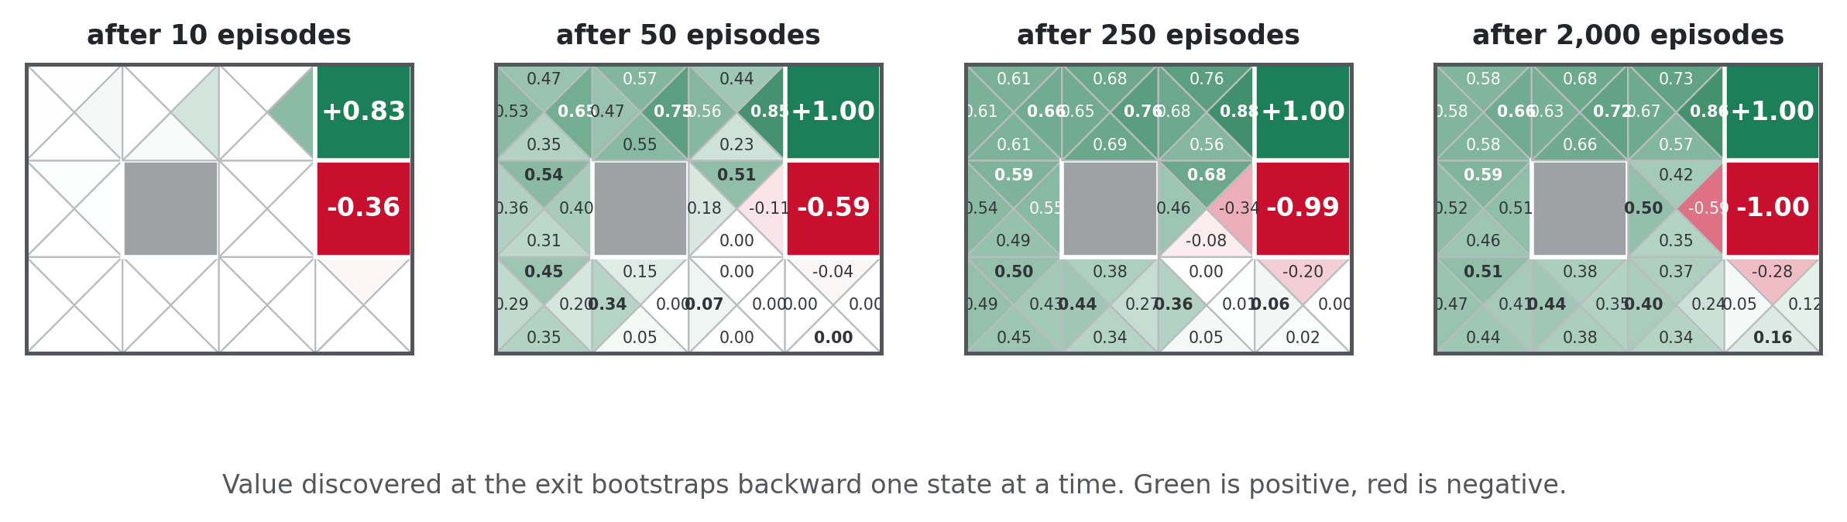
Value spreading backward from the exit
Four snapshots from one training run. Each triangle is one action's Q-value.
After 10 episodes only the squares adjacent to the terminals know anything. By 50 the good news has reached the middle of the board. By 2,000 the whole grid has coherent values and the greedy path is visible as a chain of the darkest green triangles.
Nobody told the agent where the exit was. It found out, then told its neighbours, who told theirs.
COMP 469 · Reinforcement Learning I · CSU Channel Islands
53
Notes:
[2 min] Let them look before you talk. The picture does the work. Trace one path with a pointer from the exit backward to the start and narrate the bootstrapping chain: this square learned from that one, which learned from the exit. Point out the red region around the −1 terminal spreading too. Bad news propagates by exactly the same mechanism, which is how the agent learns to keep its distance from the cliff. This figure is generated from the same tabular Q-learning implementation they will write in Project 3. Nothing here is illustrative-only.

Slide 54
THE SURPRISING PART
Q-learning converges to optimal even if you act badly
The bootstrap term is maxₐ' Q(s', a') — the best action known from the landing state, not the action the agent actually takes next. That one choice decouples what is learned from how the agent behaves.
You can act almost completely at random and still learn the optimal Q-values.
Provided every state-action pair keeps getting tried, the estimates converge to Q*, no matter how poor the policy generating the experience is. This is called off-policy learning.
Behaviour policy
Target policy
What the agent actually does to generate experience. Can be random, can be terrible, can walk into the pit on purpose.
What the agent is learning about: the greedy policy with respect to Q. Never actually executed during learning.
Contrast with TD value learning
With no max to shield it, plain TD would let a repeated bad experience drag down the predecessor's estimate, because it uses whatever actually happened. The max over Q-values is exactly what insulates a state's known good option from being corrupted by bad exploratory choices made out of the same landing state.
COMP 469 · Reinforcement Learning I · CSU Channel Islands
54
Notes:
[4 min] This result is not obviously possible and students should be told that it surprised the field. It is the property that unlocked modern RL. If you have the applet, demonstrate it: deliberately and repeatedly walk the agent south into the −10 pit from a state whose other action is already estimated around 0.94. Two things visibly fail to happen. First, the good action's value does not degrade and keeps propagating backward normally. Second, the bad action does not even get flagged as clearly bad right away, because the pit-adjacent square still has other zero-valued escape routes and the update bootstraps off the best of them. Practical consequence worth naming: this is why you can learn from logged data, from a human demonstrator, or from an old policy's replay buffer. The experience does not have to come from the policy you are trying to learn. That is the foundation of deep Q-networks and of offline RL generally.

Slide 55
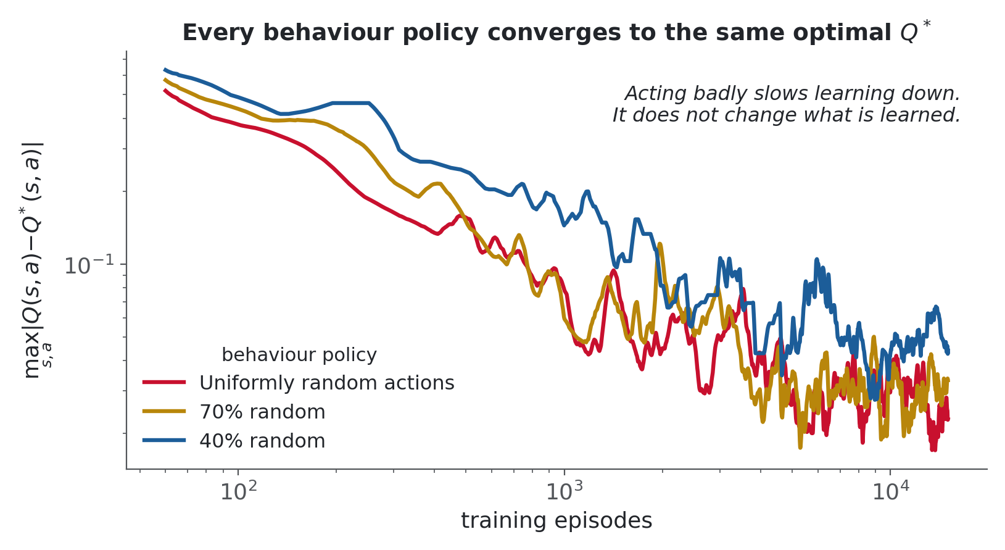
The same optimal answer from three different behaviours
One implementation, three behaviour policies, error measured against Q* from value iteration.
Acting badly changes how long learning takes. It does not change what is learned.
COMP 469 · Reinforcement Learning I · CSU Channel Islands
55
Notes:
[2 min · OPTIONAL, cut this first if you are behind] Read the red curve first: that agent chose uniformly at random on every single step for 15,000 episodes. It never once tried to do well. Its Q-values still converged to within 0.02 of optimal. Both axes are log scale, so the steady downward slope is genuine convergence rather than a plateau. Anticipate the obvious objection: if random works, why explore cleverly at all? Two answers. First, the reward you collect while learning is terrible, and in the real world that cost is real. Second, in large state spaces random walking never reaches the interesting regions at all. Both push toward the next lecture.

Slide 56
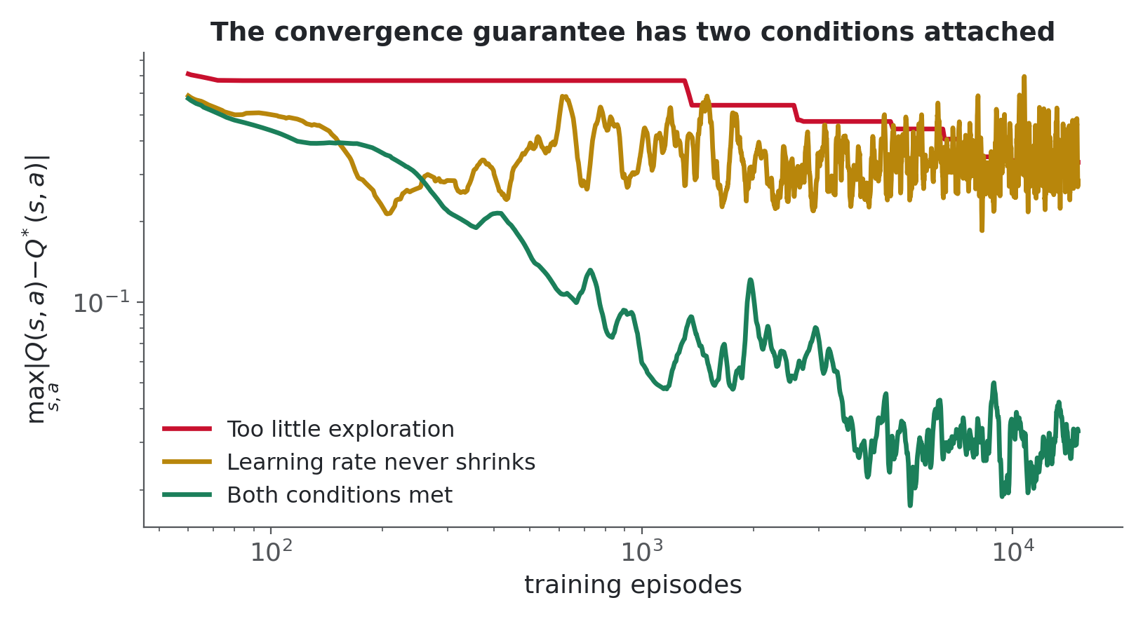
The guarantee has conditions
Both are easy to violate, and both fail quietly rather than loudly.
You have to explore enough
Every state-action pair must keep being tried. An agent that goes greedy too early stops sampling alternatives and locks in whatever it happened to believe.
α must shrink, but not too fast
A learning rate that never decreases leaves the estimates rattling around the true values forever. One that collapses too quickly freezes them before they arrive.
In the limit, action selection does not matter
Given both conditions, how you choose actions affects only the speed.
Both failures were produced with the same code as the previous slide. Only the exploration rate and α schedule changed.
COMP 469 · Reinforcement Learning I · CSU Channel Islands
56
Notes:
[3 min] These are not footnotes. They are the two things that will actually go wrong in Project 3. Red curve: exploration set to 2 percent. The agent commits early, stops sampling, and the error flattens out around 0.33 and stays there. It looks converged. It is not - it is stuck. Amber curve: constant alpha of 0.3. Notice it descends and then oscillates permanently. With a fixed learning rate every new sample yanks the estimate around by a fixed fraction, so it never settles. The visual signature is a noisy floor rather than a smooth descent. Green is both conditions satisfied. Tell students to recognise these two signatures when debugging: a flat plateau means insufficient exploration, a noisy floor means alpha never shrank.

Slide 57
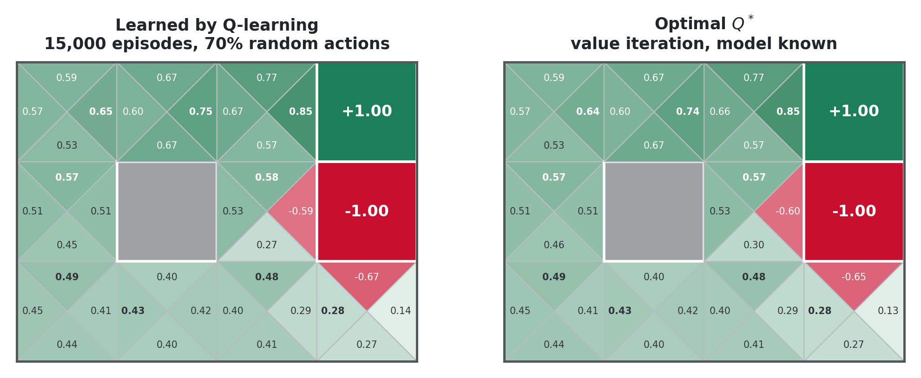
Learned from experience versus computed from the model
Left: Q-learning after 15,000 episodes of mostly random behaviour. Right: value iteration with full knowledge of T and R.
The agent never saw T or R. It recovered the same policy anyway, from nothing but observed transitions.
COMP 469 · Reinforcement Learning I · CSU Channel Islands
57
Notes:
[2 min] The payoff slide for the whole lecture. Let it land. Have them compare cell by cell. The numbers agree to roughly two decimal places almost everywhere, and the arrangement of which triangle is darkest - which is the greedy action - matches everywhere that matters. Restate what the left panel actually had access to: a stream of (s, a, s', r) tuples produced by an agent choosing at random 70 percent of the time. No transition probabilities. No reward function. No lookahead. Four lines of update rule. Then be honest about the caveat that motivates the rest of the course: this grid has eleven states. Everything here is a table indexed by state and action, and that table is hopeless for backgammon or Atari or anything with a camera. Fixing that is function approximation, which is where RL II ends up.

Slide 58
8
AIMA 22.3.1, next lecture
Where this leaves off
Q-learning tolerates a bad policy. It still needs some policy, and that policy has a decision to make on every step.
COMP 469 · Reinforcement Learning I · CSU Channel Islands
58

Slide 59
Exploration versus exploitation
Q-learning converges regardless of how experience is generated, but something still has to generate it. On every single step that generator faces one choice.
Exploit
Explore
Take the action that currently looks best.
Take something you have poor data on.
Collects reward now. Learns nothing new. Risks committing to an option that only looks good because the alternatives were never properly tried.
Buys information. Costs reward now, and in a world with real consequences that cost can be a crashed drone rather than a lost point.
One imperfect but workable answer: ε-greedy
Take the best known action, except with probability ε, in which case act at random. It satisfies the exploration condition, it is one line of code, and it is crude: it explores just as hard in states it already understands perfectly as in states it has barely visited. Fixing that is next lecture.
This is the last thing the algorithms we built cannot decide for themselves.
COMP 469 · Reinforcement Learning I · CSU Channel Islands
59
Notes:
[3 min] Close the loop opened in the very first section. Problem 4 with model-based learning was that nothing told the agent how to go get the data it needed. We have not solved that. We have built three algorithms that all assume the experience shows up somehow. If the crawler applet is still running, demonstrate epsilon live. At around 40 percent random the crawler visibly flails and explores messily. Turn epsilon to zero and force it to always take its best known action, and it commits fully to what it has learned. The contrast is dramatic and students remember it. Be honest about epsilon-greedy's weakness so RL II has somewhere to go: it explores uniformly, wasting effort on states it already understands. Better schemes direct exploration where uncertainty actually is.

Slide 60
Four methods, side by side
If you learn one table for the exam, learn this one.
Model-based
Direct evaluation
TD learning
Q-learning
Learns
T̂ and R̂
Vπ(s)
Vπ(s)
Q(s, a)
Needs a model
builds one
no
no
no
Updates when
on solve
episode end
every step
every step
Uses connectivity
yes
no
yes
yes
Gives a policy
yes
no
no
yes
Finds optimal π
yes
no
no
yes
On/off policy
n/a
on
on
off
AIMA section
22.2.2
22.2.1
22.2.3
22.3.3
Only two rows separate Q-learning from TD learning, and those two rows are the entire reason Q-learning exists.
COMP 469 · Reinforcement Learning I · CSU Channel Islands
60
Notes:
[3 min] Walk the columns, not the rows. Each column is one algorithm's complete profile. The two rows that matter are 'gives a policy' and 'finds optimal'. Direct evaluation and TD both answer 'how good is this policy'. Neither answers 'what should I do'. Q-learning answers both, and it does so because it indexes by action and takes a max. The on/off policy row is the one students most often cannot explain on an exam. Make them say it back: Q-learning is off-policy because its bootstrap uses the best available action from the landing state, not the action the behaviour policy will actually take. Note the gap in the model-based column under 'updates when'. It re-solves periodically rather than continuously, and that is a real practical cost.

Slide 61
Five things to carry out of this room
1
RL is an MDP with T and R withheld.
The formalism is unchanged. Only the agent's access to it changed.
2
Any expectation can be replaced by a running average of samples.
This one substitution generates every model-free algorithm in the lecture.
3
TD learning exploits connectivity; direct evaluation throws it away.
That is why B and E came out at +8 and −2 when they had to be equal.
4
Learn Q-values, not state values, if you intend to act.
Q makes action selection model-free. V does not.
5
The max inside the Q update is what makes learning off-policy.
You can behave terribly and still converge to optimal behaviour.
COMP 469 · Reinforcement Learning I · CSU Channel Islands
61
Notes:
[2 min] Read all five aloud. This is the slide students photograph. If you are short of time, cut anything else and keep this. Numbers 2 and 5 are the conceptual load-bearing ones and are the most likely short-answer exam questions.

Slide 62
Where marks get lost
Every one of these has cost students points on a previous exam.
Updating the state you arrived in
TD and Q-learning both update the state, or state-action pair, you just LEFT. The landing state is read only.
Using the immediate reward as the return
A direct-evaluation sample is the sum of all rewards from that visit to the end of the episode, not the next one.
Counting a reward you already paid
The step that carried you into s is not part of V(s). Values are about the future.
Confusing maxₐ' with the action actually taken next
The Q bootstrap uses the best available action from s'. That is what makes it off-policy.
Claiming TD learning finds the optimal policy
TD evaluates a fixed π. It computes Vπ, not V*, and yields no policy at all.
Forgetting that γ applies to the bootstrap only
In sample = r + γ V(s'), the immediate reward r is never discounted.
COMP 469 · Reinforcement Learning I · CSU Channel Islands
62
Notes:
[2 min · OPTIONAL, cut this first if you are behind] Go through these briskly. The value is in naming them so students recognise the error when they are about to make it. The last one is subtle and worth a sentence. In sample = r + gamma V(s'), gamma multiplies only the bootstrapped value. The immediate reward arrives now, so it is undiscounted. Students who have memorised the return formula sometimes discount r as well. Trap five is the one that separates a B from an A. If a question asks how to improve a policy and the answer given is TD learning, that answer is wrong regardless of how well the update is executed.

Slide 63
Practice before next session
The first two are mechanical and should take fifteen minutes. The third is the one worth thinking about.
By hand
Using the four episodes from this lecture, compute V(A) through V(E) by direct evaluation without looking at the slides. Then explain in two sentences why your V(B) and V(E) differ when they should not.
1
By hand
Starting from all zeros with α = 0.5 and γ = 1, run TD learning through episode 1, then episode 3, in order. Report V(B), V(C), V(D), V(E) after each transition.
2
Think
Q-learning converges to optimal Q-values while following a random policy. So why would anyone bother with a good behaviour policy at all? Give two distinct reasons, one about cost and one about scale.
3
Read
AIMA 22.1 through 22.3.3. Skim 22.3.1 on exploration so next lecture is a second pass rather than a first.
4
Project 3 implements exactly the update on the Q-learning slide. Start it before the exploration lecture, not after.
COMP 469 · Reinforcement Learning I · CSU Channel Islands
63
Notes:
[2 min · OPTIONAL, cut this first if you are behind] Question 3 is the bridge into next lecture and the one worth grading carefully. The two answers you want are: the reward collected during learning is real and a random policy collects almost none of it, and in a large state space a random walk never reaches the interesting states at all so convergence in the limit is worthless. Push the Project 3 timing hard. Students who wait until after the exploration lecture end up implementing the update and the exploration strategy at the same time, and then cannot tell which one is broken.

Slide 64
NEXT SESSION
Reinforcement Learning II
Exploration strategies
AIMA 22.3.1
ε-greedy properly analysed, then exploration functions that direct effort toward genuine uncertainty rather than spreading it uniformly.
Regret
AIMA 22.3.1
A cleaner way to score a learner than final policy quality: how much reward did you give up on the way there?
Approximate Q-learning
AIMA 22.4
Tabular Q dies at scale. Represent states by features and learn weights instead, which is what makes RL work on problems with more states than atoms.
The gridworld has eleven states. Everything today was a table. Next lecture is about what happens when a table is no longer an option.
COMP 469 · Reinforcement Learning I · CSU Channel Islands
64
Notes:
[1 min · OPTIONAL, cut this first if you are behind] Leave them with the scaling problem. It is the honest limitation of everything we did today and it is what makes the next lecture necessary rather than optional. Concrete numbers land well here: backgammon has on the order of 10 to the 20 states. A single Atari screen has 256 to the power of 33,600 possible frames. No table survives either.

Slide 65
Sources and attribution
Russell, S. and Norvig, P.
Artificial Intelligence: A Modern Approach, 4th edition. Chapter 22, Reinforcement Learning. Pearson, 2021.
Klein, D. and Abbeel, P.
CS 188 Introduction to Artificial Intelligence, University of California, Berkeley. Lecture 11, Reinforcement Learning. Materials at ai.berkeley.edu.
Sutton, R. and Barto, A.
Reinforcement Learning: An Introduction, 2nd edition. MIT Press, 2018. The standard reference for everything in this lecture and well beyond it.
Watkins, C. and Dayan, P.
Q-learning. Machine Learning, 8(3-4), 279-292, 1992. The convergence result behind the off-policy property.
Kohl, N. and Stone, P.
Policy gradient reinforcement learning for fast quadrupedal locomotion. ICRA, 2004. The AIBO gait example.
Figures in this deck were generated for COMP 469 from a verified tabular RL implementation. Every numeric result shown was computed, not reproduced. Slide structure follows CS 188 Lecture 11; all CS 188 materials are available at ai.berkeley.edu.
COMP 469 · Reinforcement Learning I · CSU Channel Islands
65
Notes:
[1 min · OPTIONAL, cut this first if you are behind] Point students at Sutton and Barto specifically. It is freely available from the authors and it is the book to read if any of today was interesting enough to pursue. The attribution note matters. The Berkeley materials are openly licensed for exactly this kind of reuse and the courtesy of saying so is worth the line.

